Slide 1
ODR is here to stay: Get over it.
#LegalTech #ODR #NCSC
Paul Embley
National Center for State Courts

Slide 2
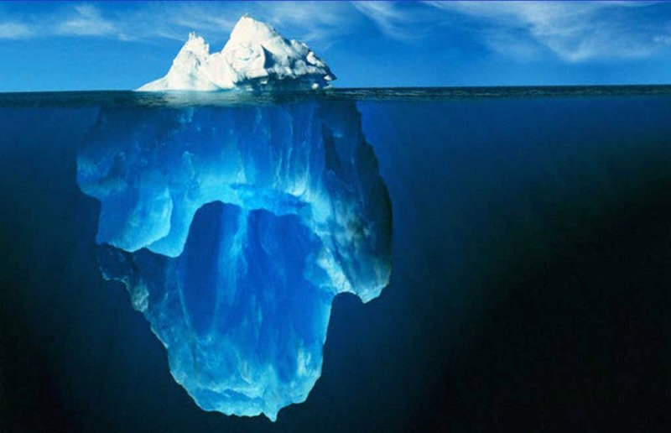
Most Civil Justice Problems Do Not Make It to the Justice System
USA: 14 to 24% of
people’s
actual justice problems
What courts and
lawyers see
Civil justice problems of the public
What courts and lawyers never see
USA: 76 to 86% of
people’s
actual justice problems

Slide 3
Bangalore Principles
“Even when all other protections fail, the judiciary provides a bulwark to the public against any encroachments on rights and freedoms under the law”
Rights and freedoms are “human rights”
Giving access to justice & rendering justice to millions of people deprived from remedy forms part of the judicial integrity, because if we cannot ensure that people have access to justice and that we are delivering justice, what purpose do the 6 values serve?
It is our role to contribute to resolve disputes by giving access to justice while respecting the values of judicial integrity
Notes:
Independence,
Impartiality,
Integrity,
Propriety,
Equality,
Competence,
Diligence

Slide 4
Access to Justice
Access to justice and access to Internet are human rights
Impeding access to justice equates to denial of justice
Giving access to public & private justice online contributes to cure denials to many people who have no other means to seek remedy
No longer sustainable to keep technology outside of court rooms
ODR assists judges with dealing with small and medium claims so that they can concentrate on more pressing matters
We walked on the moon, yet justice is not online! Give access to justice online now and not in 2100

Slide 5
Key Themes
“Broken” is hyperbolic. However… there are enormous and expanding fissures in our lack of accessible and affordable justice—the access-to justice (or A2J) gap.
To bridge the gap we need to change our legal ecosystem by creating new delivery channels for legal services, including through investing in and harnessing technology.
ODR is one delivery channel and preliminary findings from Utah’s ODR initiative show promising progress.
Notes:
Let’s talk themes (3):
First, I admit that calling the judicial system “broken,” as I have in the title of my presentation, is hyperbolic. But what is more problematic is taking the position that everything is hunky-dory and that we’re not experiencing an enormous and expanding fissures in in our lack of accessible and affordable justice—what we all refer to as the access-to justice (or A2J) gap.
Second, to bridge the gap we need to change our legal ecosystem by creating new delivery channels for legal services, including through investing in and harnessing technology.
Third, I’d like to offer you all a more in-depth look into one of those channels, Utah’s ODR model, and I’ll report on some preliminary findings regarding that model by National Center for State Courts.

Slide 6
“Poor people have access to the American courts in the same sense that the Christians had access to the lions when they were dragged into a Roman arena.”
Retired California Court of Appeals
Justice Earl Johnson, Jr.
“Colosseum (229913207) by Mathew Schwartz, used under CC BY / Desaturated from original
Notes:
Theme 1—The Ever-Expanding Access-to Justice Gap in the United States:
[Slide quote] I need to thank Paul Embley from the National Center for spotting this quote; I thought it a powerful metaphor from the moment I first saw Paul use it to emotionally bring home the A2J gap in our court system
Now, I’m not going to spend an enormous amount of time this morning talking about the A2J gap. If any of you here are still debating whether the A2J gap exists despite the mountain of evidence to the contrary, then this isn’t the presentation for you.
But just to put a pin in it, the United States is tied for 99th of 126 countries when it comes to access and affordability of civil justice. When I describe where we sit, I like to evoke my cowboy heritage and tell folks that “while we’re not dead last, we’re close enough to spit and hit it.”
Let’s take a quick look at just one aspect of the gap—unrepresented parties.

Slide 7
More Quotes
“Ironically, the pandemic has done more to advance technology in the courts than 10 years of work at NCSC.” – Dr. Tom Clarke
“Most [courts] are learning months’ worth of lessons in days. They are learning new skills because they had to. Once you have to ... you keep the parts that are helpful. This was not the disruption we wanted, but it was the disruption we needed.” – Chief Justice Bridget McCormack
Notes:
Independence,
Impartiality,
Integrity,
Propriety,
Equality,
Competence,
Diligence

Slide 8
Almost all the remote courts that have been set up in response to the virus are variations on the theme of traditional courts. But we should be clear: dropping our current court system into Zoom is not a shift in paradigm…
We are at the foothills of the transformation in court services. The current array of remote courts is a valiant collection of ad hoc services, but much work and investment will be needed to industrialize these efforts, to build court capabilities that are scalable, stable, and, crucially, designed for use as much by lay people as by lawyers. – Richard Susskind, OBE
Notes:
Independence,
Impartiality,
Integrity,
Propriety,
Equality,
Competence,
Diligence

Slide 9
Courts are not meeting needs and the people have noticed:
59% of voters agree that courts are not doing enough to empower regular people without legal help.
Notes:
Question, we shouldn’t worry because the public thinks the courts are doing a good job managing the A2J crises? Answer, false. 6 in 10 Americans say the courts are failing ordinary Americans.
Historically, the judicial system in this country has succeeded because of high public confidence. I suggest to you that those halcyon days are about to come to an end if we don’t act intentionally, decisively, and rapidly to address the A2J gap.

Slide 10
Q: “If you had business with the courts, and this service was available online, how likely would you be to use it?”
Attitudes Towards Using Remote Court Services
Percent saying they would appear via videoconference for their own case.
2014
2020
43%
64%
Would Use
55%
33%
Wouldn’t Use
State of the State Courts in a (Post) Pandemic World

Slide 11
Most Americans Have the Technology Tools for Remote Participation
85%
Subscribe to internet at home
95%
Own a cell phone
85% Smartphone
No home internet, no cell phone
2.4%
State of the State Courts in a (Post) Pandemic World
Notes:
Presenter notes
Over 65, 20% don’t have a smartphone
Digital divide -- more of a spectrum/continuum than a gap

Slide 12
The Future Is Technology
“The importance of technology in our daily lives is undeniable. This is due to the fact that in today’s dynamic world, life without technology is meaningless.”
eimportanceoftechnology.com (last visited 10/23/19)
Notes:
Here’s one view, albeit greatly exaggerated.
To be clear, I don’t agree that “life without technology is meaningless,” but it is clear that it has permeated every facet of our lives. And those organizations that have realized the disruptive effect and value of technology and gotten “with it” have thrived; those that haven’t, well, may they rest in peace.
Knowing this, our justice system not only should embrace technology, it must if it is to stay truly relevant: think electronic filing and notice, digital recordings, computer-aided translation, online forms, online assistance, remote appearances, and the list goes on.
And think of bringing all of these technologies together, and more, in ODR.

Slide 13
Soup to Nuts: ODR in Utah
Notes:
Theme 3—An In-depth Look Into Utah’s ODR Model and a Report on Some of the Preliminary Findings Regarding that Model by the National Center for State Courts:
A soup to nuts history of Utah’s ODR efforts for the purposes of contextualizing the remainder of the discussion.
Roughly 3, 3 & 1/2 years ago began the process. . . .
. . . . Nearing the completion of the independent evaluation by the National Center for State Courts.
Much of the data and language that follows is taken from a draft of that report. And I really need to emphasize this is all preliminary and subject to change.

Slide 14
Key Finding:
Pre-ODR
9 minutes / case
Court Staff Prep Time Per Case is Down
ODR
5 minutes / case
Notes:
Unplanned consequence; happy accident: 45% time savings in court staff time per case.
How this scales.
Based on data collected by pilot test court (versus NCSC study).
Time savings:
Case initiation in data entry, document scanning, and uploading;
When service is reported to the court; and
When the case is resolved.
5. Allows for more assistance by clerks; hence A2J improvement.

Slide 15
Key Finding:
45% Reduction in court staff time per case
Court Staff Prep Time Per Case is Down
Notes:
Unplanned consequence; happy accident: 45% time savings in court staff time per case.
How this scales.
Based on data collected by pilot test court (versus NCSC study).
Time savings:
Case initiation in data entry, document scanning, and uploading;
When service is reported to the court; and
When the case is resolved.
5. Allows for more assistance by clerks; hence A2J improvement.

Slide 16
Key Finding:
Number of hearings per case is down.
“Spillover” of cases from overscheduled has been eliminated.
Communication between parties is better.
Parties that do come to court are coming better prepared.
Fewer Hearings
Notes:
The A2J aspect seems apparent—fewer unnecessary trips to the courthouse mean less intrusion and less expense. “The number of hearings per case has gone down since . . . ODR was introduced. . . . Earlier, more cases would be scheduled for hearing than could reasonably be brought before the court in one day. The resulting backlog meant that parties would have to come back to be heard another day. Better communication between the parties involved, throughout the process, by virtue of the option to chat on the platform has also played a part in reducing the number of hearings. The parties are better prepared for the proceedings and they can be completed in a timely manner.”
How much less, you ask. . . .

Slide 17
Key Finding:
Pre-ODR
1,022 unique cases
2,255 hearings
2.66 average hearings/case
Fewer Hearings
ODR
743 unique cases
941 hearings
1.5 average hearings/case
Notes:
“For the baseline[], 1022 unique cases ha[d] 2255 hearings. The mean number of hearings per case was 2.66 and there was a maximum of 8 hearings for a case. Since the launch of the ODR platform, 743 cases had 941 hearings. There has been an average of 1.5 hearings per case and a maximum of 4 hearings for a case.”

Slide 18
Key Finding:
44% Reduction in number of hearings
Fewer Hearings
Notes:
Put differently, ODR has resulted in a 44% reduction in the number of hearings.
What about time to disposition?

Slide 19
Key Finding:
Pre-ODR
93 days to first hearing
Prompter Resolution
Days from filing to first hearing
ODR
63 days to first hearing
Notes:
From the date that a case was filed it took, on average, 93 days for the first hearing to take place in the baseline period. That number was reduced by a month after the ODR system was launched, taking, on average, 63 days for the first hearing.
To be clear, this is from filing, not from service.
We see even greater improvements if we consider the time from filing to completion.

Slide 20
Key Finding:
58% Decrease in time to disposition
Prompter Resolution
Notes:
Put differently, ODR has resulted in a 58% decrease in the time to disposition.
And frankly, this significantly understates the time to disposition when both parties engage—in other words, when we measure time to disposition from service versus filing. Under the business rules we’ve established, it cannot take more than 6 weeks from service to disposition. I’m told by the clerk of the pilot court that the average time to disposition under this metric is roughly four weeks.

Slide 21
Key Finding:
ODR as of 11/2019
~ 2,000 cases filed.
Return of service in ~1,500
Many plaintiffs in the pilot are bulk filers.
Only 28 parties have opted out.
Prompter Resolution
Days from filing to first hearing
Notes:
The importance in terms of whether we have a winner: Both sides want to participate.
Consider the importance of the low-opt out rate in terms of ESL and individuals with disabilities.

Slide 22
An ODR Road Map—Step 1
Establish a small working group.
Involve judges, IT folks, and court administrators.
Identify the First Principle(s), case type, and platform architects.
Create an implementation task force, including a project champion.
Notes:
[If there’s time—describe the three easy steps to ODR success]
Establish a small working group to identify guiding principles.
The group should include judges, IT folks, and court administrators. Thought leaders from each group preferred.
The group should decide First Principles—in our case, lowering the A2J gap—in order to inform the other guiding principles.
With the First Principle in mind, the group should identify the case type and platform architects. Again, with the first principle in mind, we settled on small claims and building a platform in-house that we can take to the next level.
The group should also set up the implementation task force, including a project champion. We included, judges, clerks, and folks from IT and court services. Also, because of our emphasis on access-to-justice, for outside stakeholders we involved low-bono and pro-bono attorneys and an entrepreneur.

Slide 23
An ODR Road Map—Step 2
Liberate the implementation task force
Create a wild animal group.
Build an MVP.
Make it Mandatory.
Notes:
Unfetter the task force. (from existing rules to the greatest extent possible.)
Create a Wild Animal Group. (aka “Skunk Works”)
You all might think MVP means most valuable player. That’s what I thought coming into this arena. I was wrong. In this context MVP means minimum viable product. Why an MVP you ask. Because if you don’t; if instead you try to build something that will capture every oddball scenario that comes around you will never launch. This is an incredibly valuable lesson we were taught by our friends in B.C. who have been running a very successful ODR platform for some time.
Another lesson learned from B.C., make it mandatory. This doesn’t mean that you should make opting out difficult, but it does mean that ODR is the presumption.

Slide 24
An ODR Road Map—Step 3
Pilot the program.
Test it and test it again pre-pilot.
Notes:
I can’t emphasize enough the importance of piloting projects before a full-scale launch. This is a design lab First Principle.
Test and re-test to avoid a false negative. My story re Early Case Resolution (ECR).

Slide 25
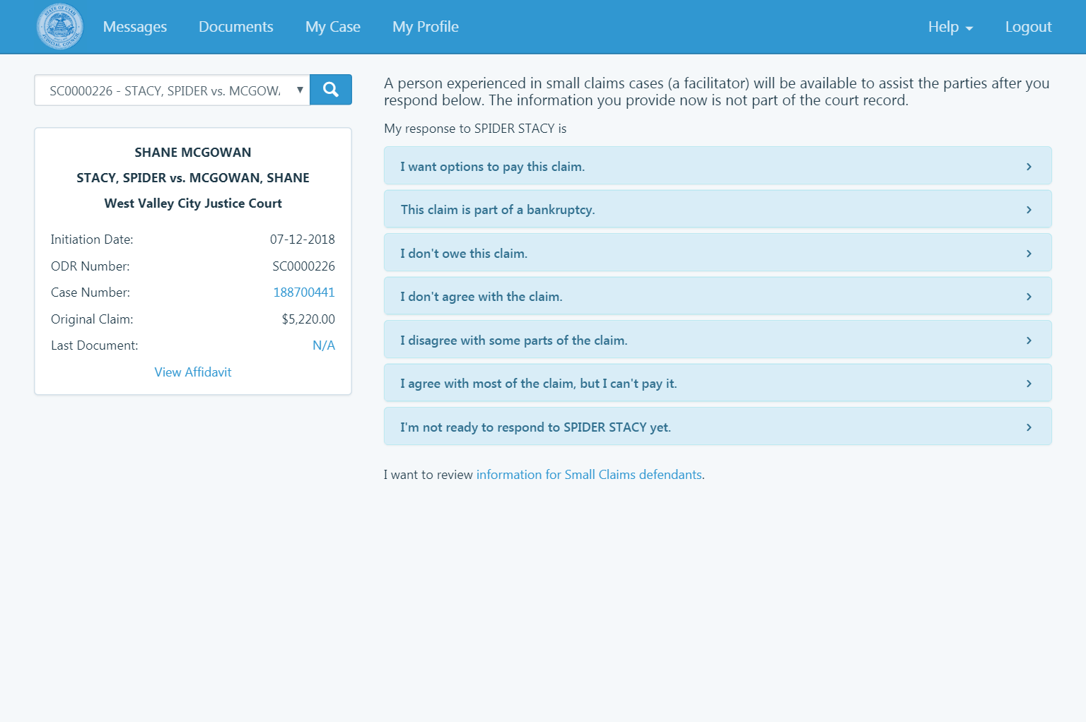
Notes:
Guided start for defendants.
We brought together legal service practitioners and plain language experts and developed a set of common responses to help the person being sued begin their communication with the plaintiff and the facilitator.
Based on the experience of our practitioners, all common responses to small claims law suit

Slide 26
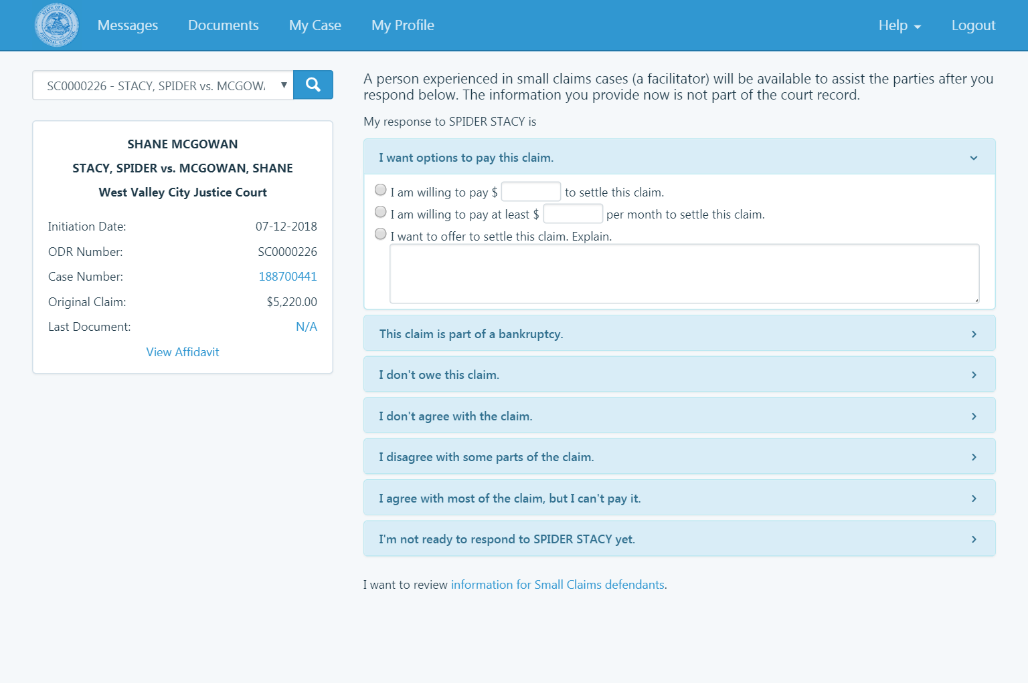
Notes:
Template allows the to construct their initial response to the plaintiff

Slide 27
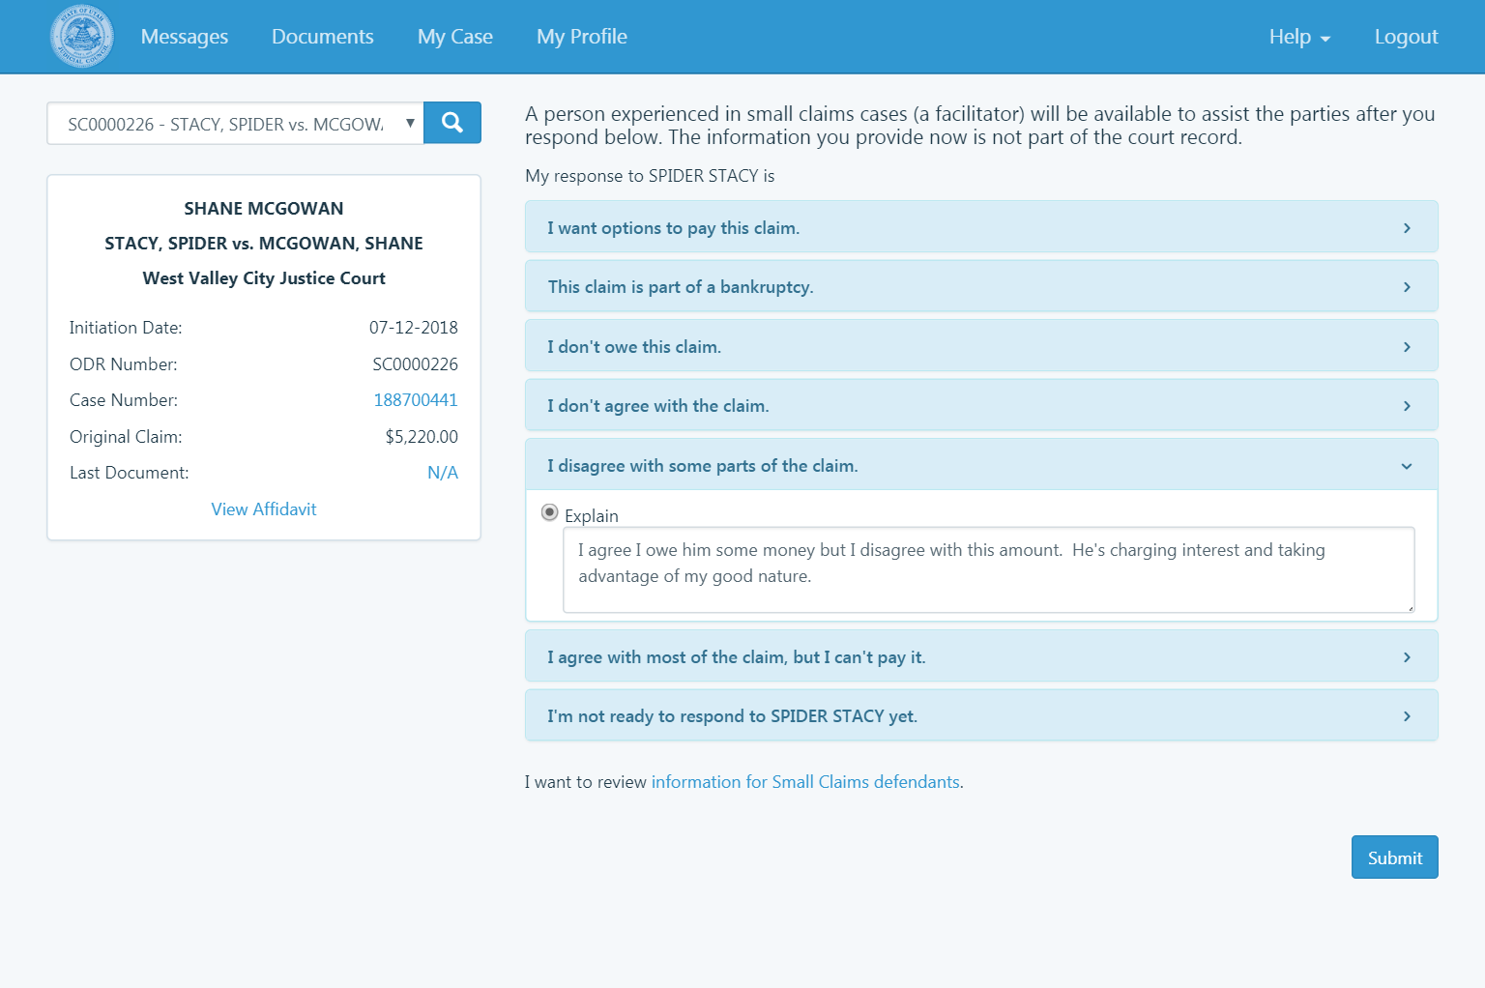
Notes:
In this example, the defendant, Mr Stacy, agrees there is a debt, but disputes the amount.

Slide 28
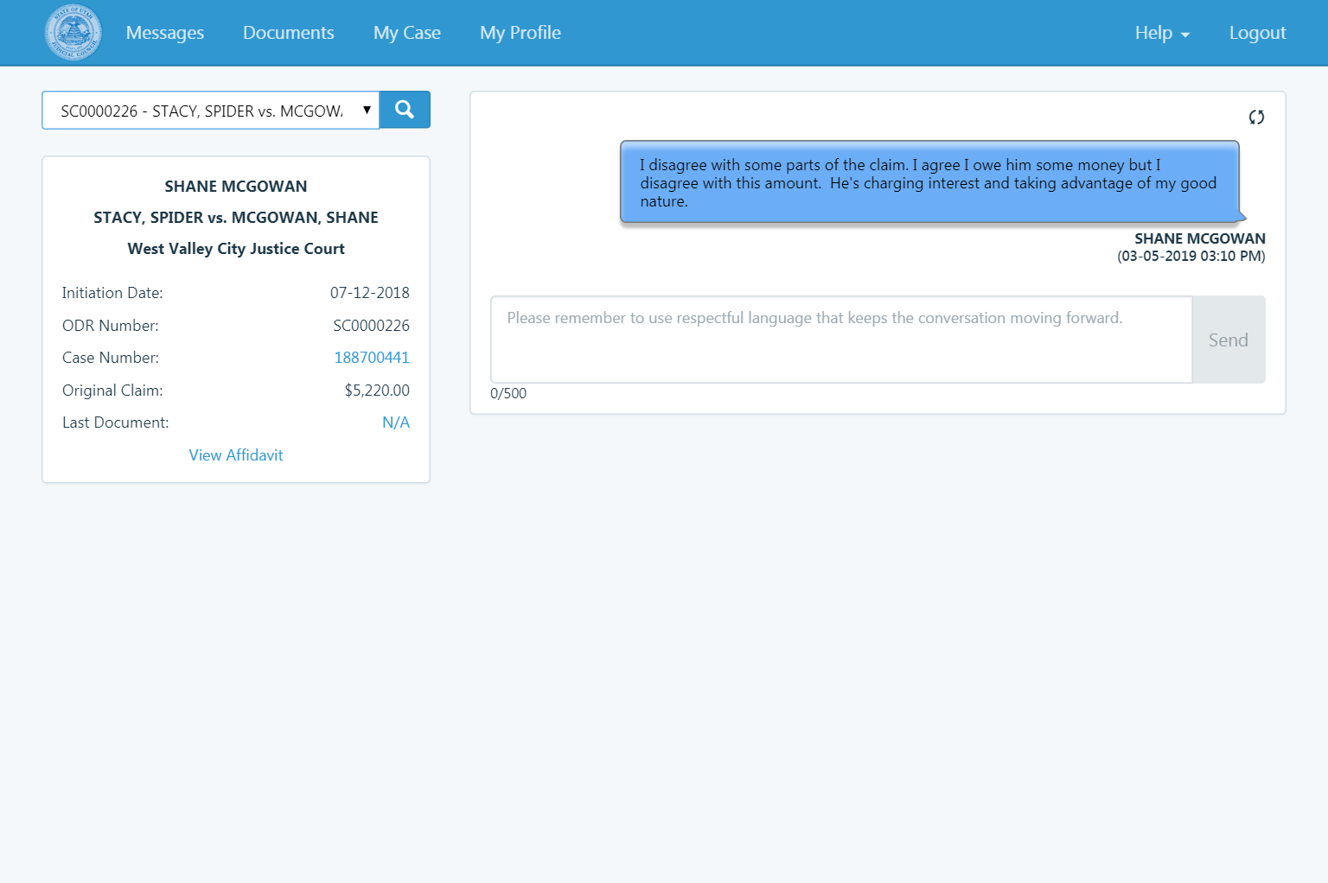
Notes:
After submitting the first message, the defendant receives notice… email or txt their choise

Slide 29
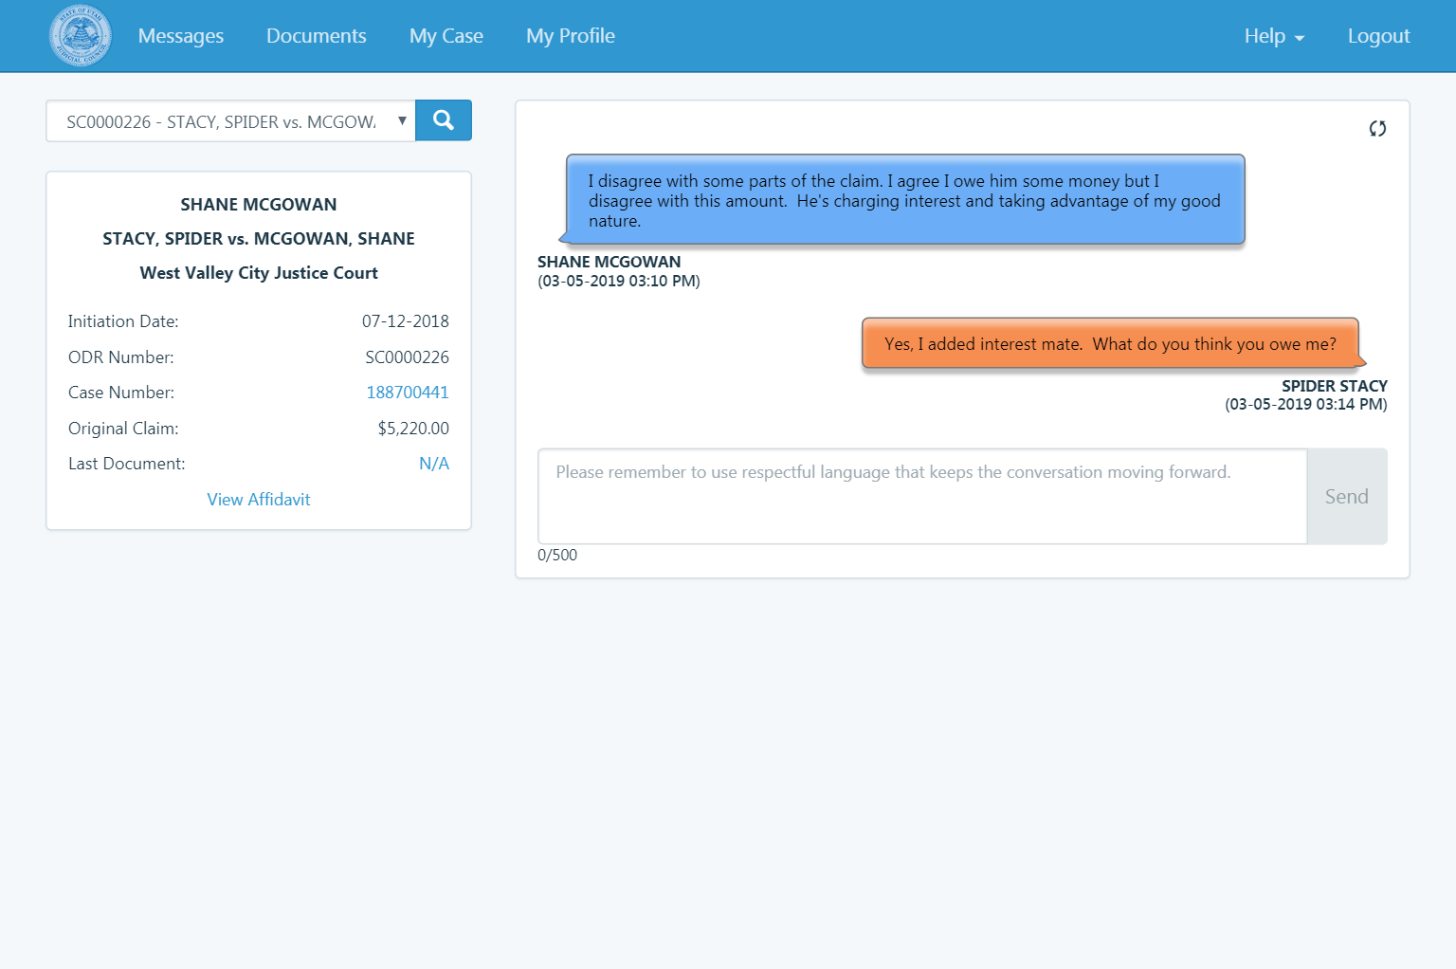
Notes:
And has the opportunity to respond.

Slide 30
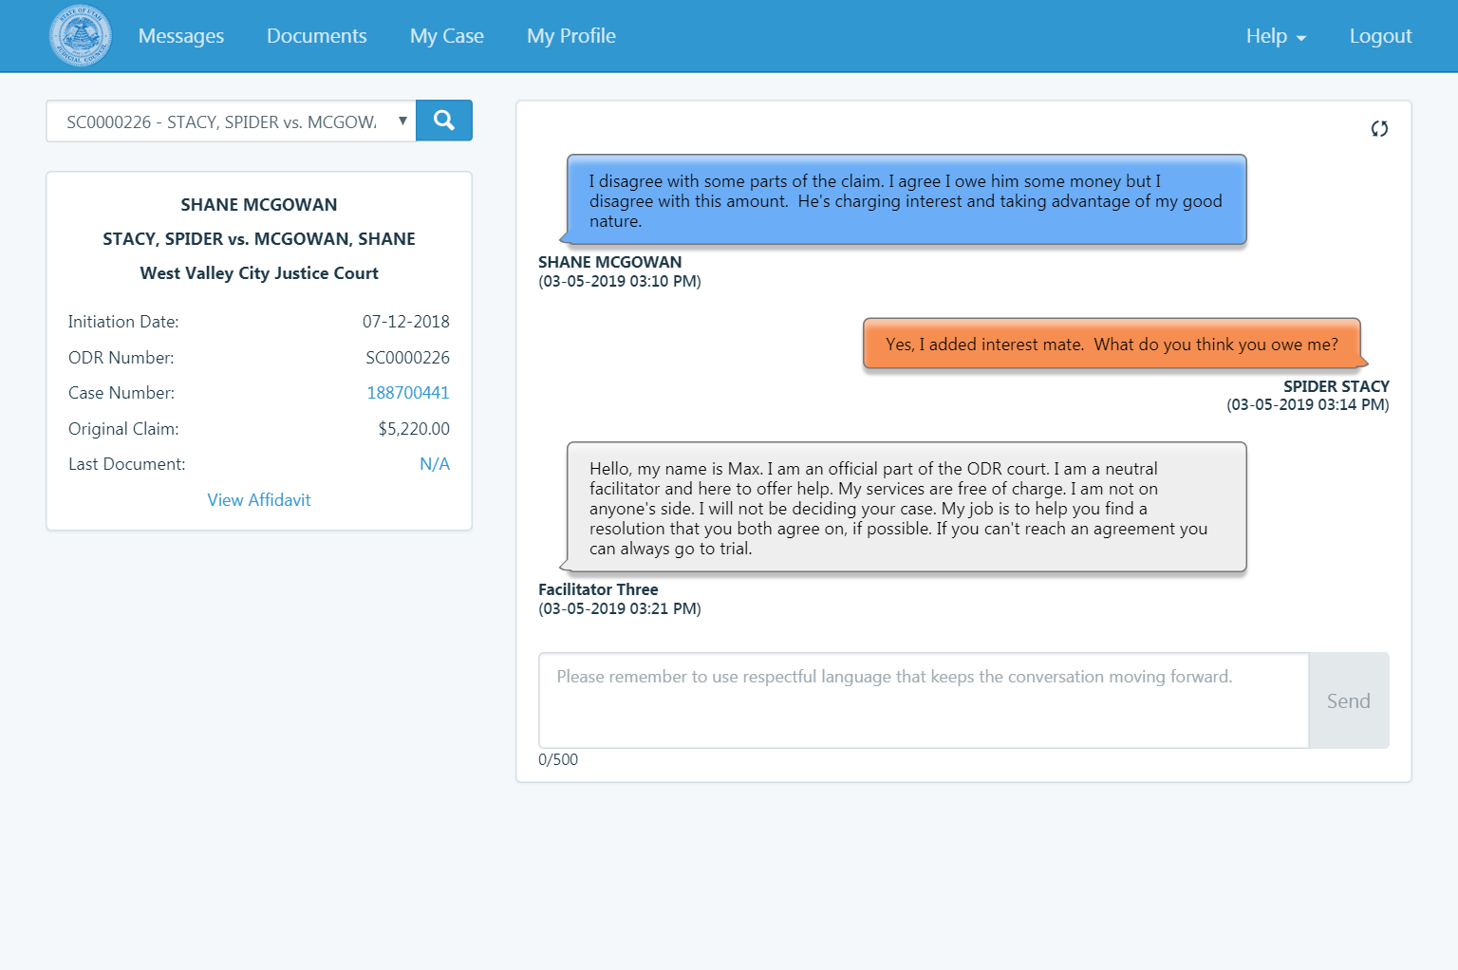
Notes:
The facilitator receives notices when both parties have joined the conversation.
Facilitator enters the conversation, identifies themselves and let both parties know what their role is.

Slide 31
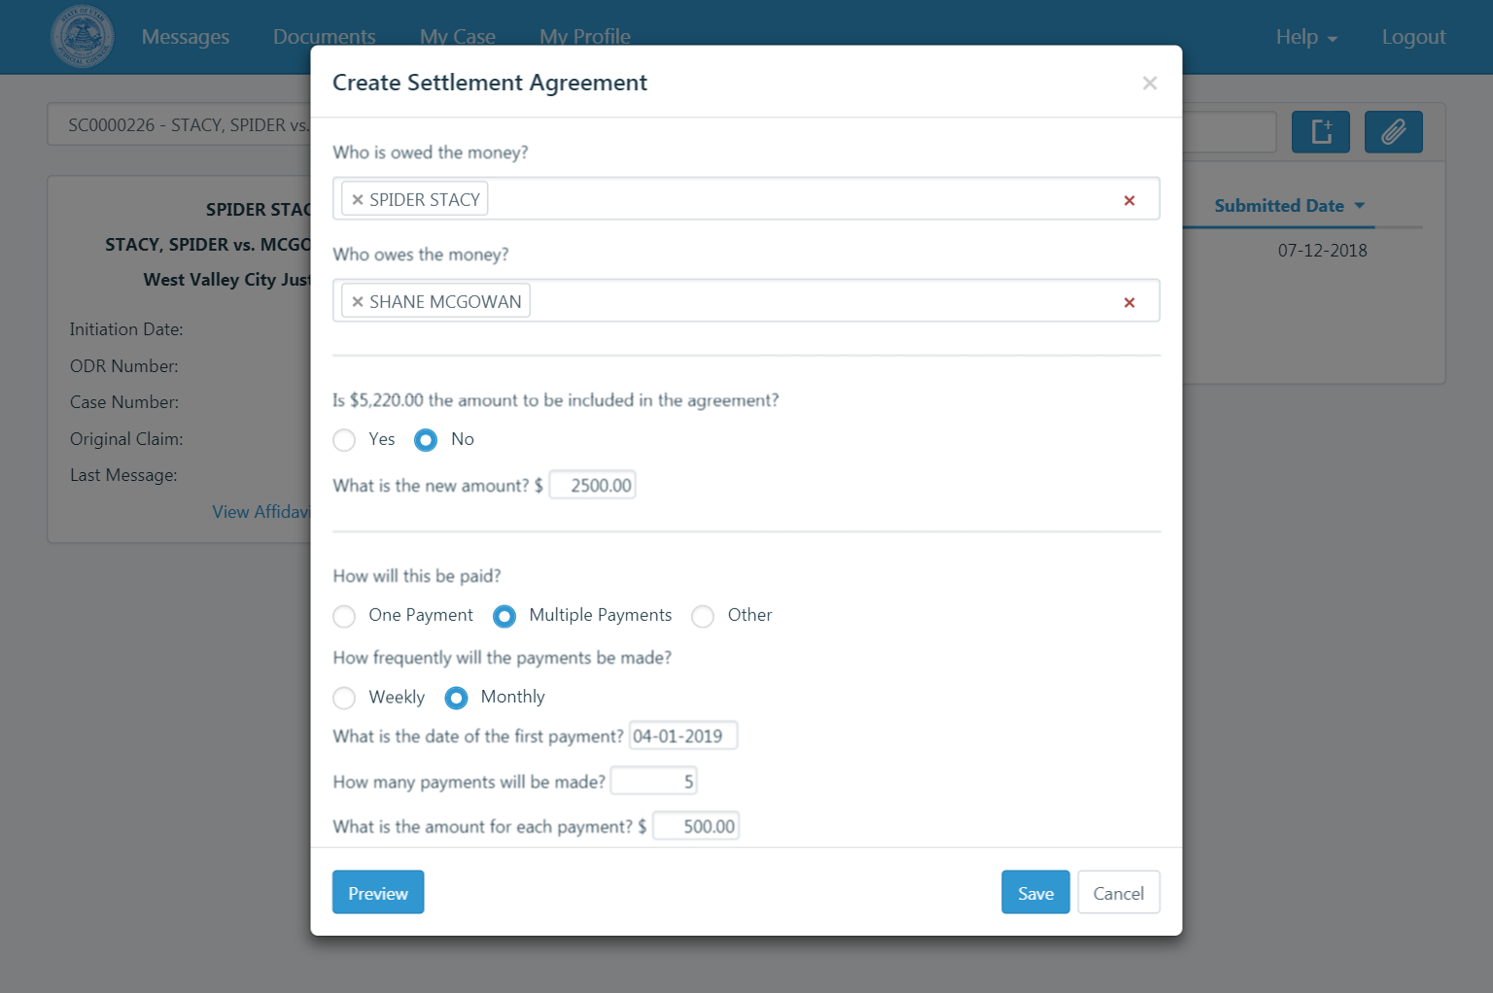
Notes:
When they are ready, a settlement agreement can be completed

Slide 32
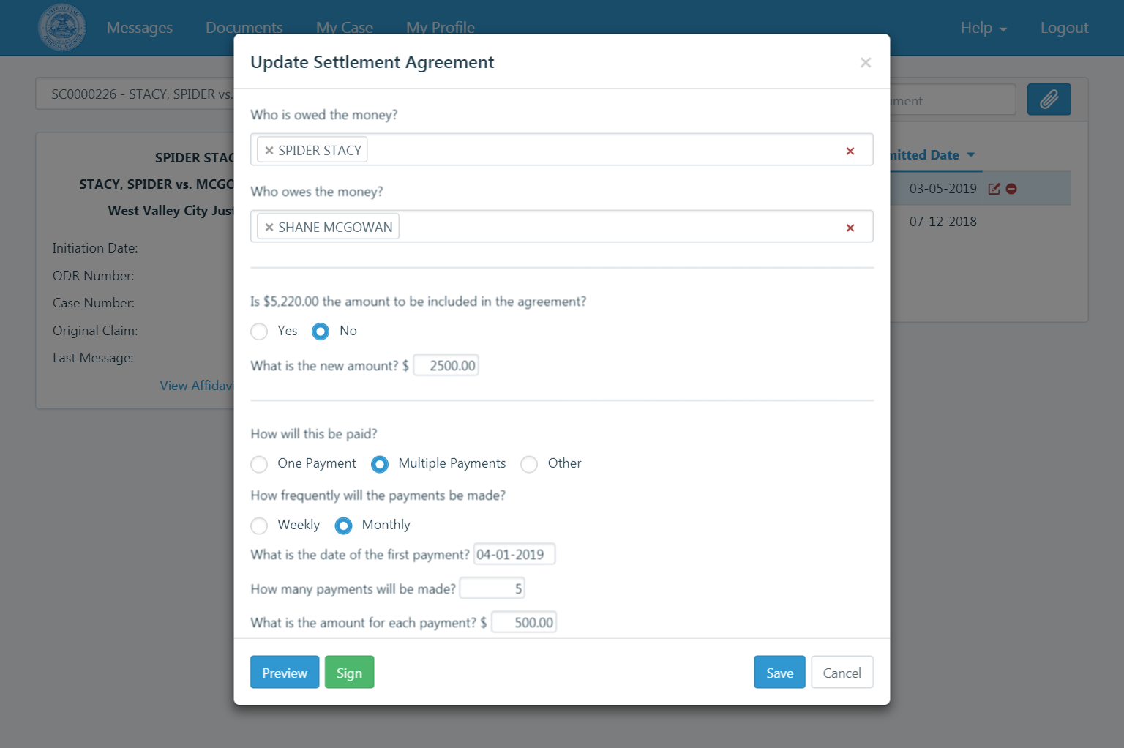
Notes:
BASIC online template

Slide 33
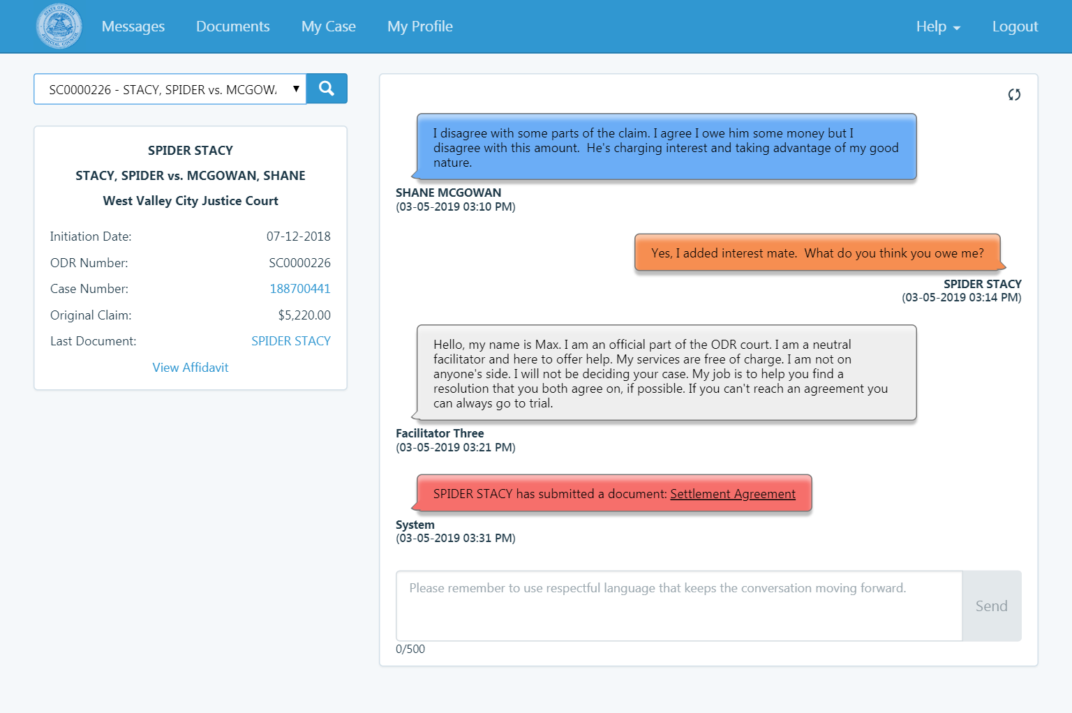
Notes:
When a document is submitted by any party, a system message is posted with a link to the document

Slide 34
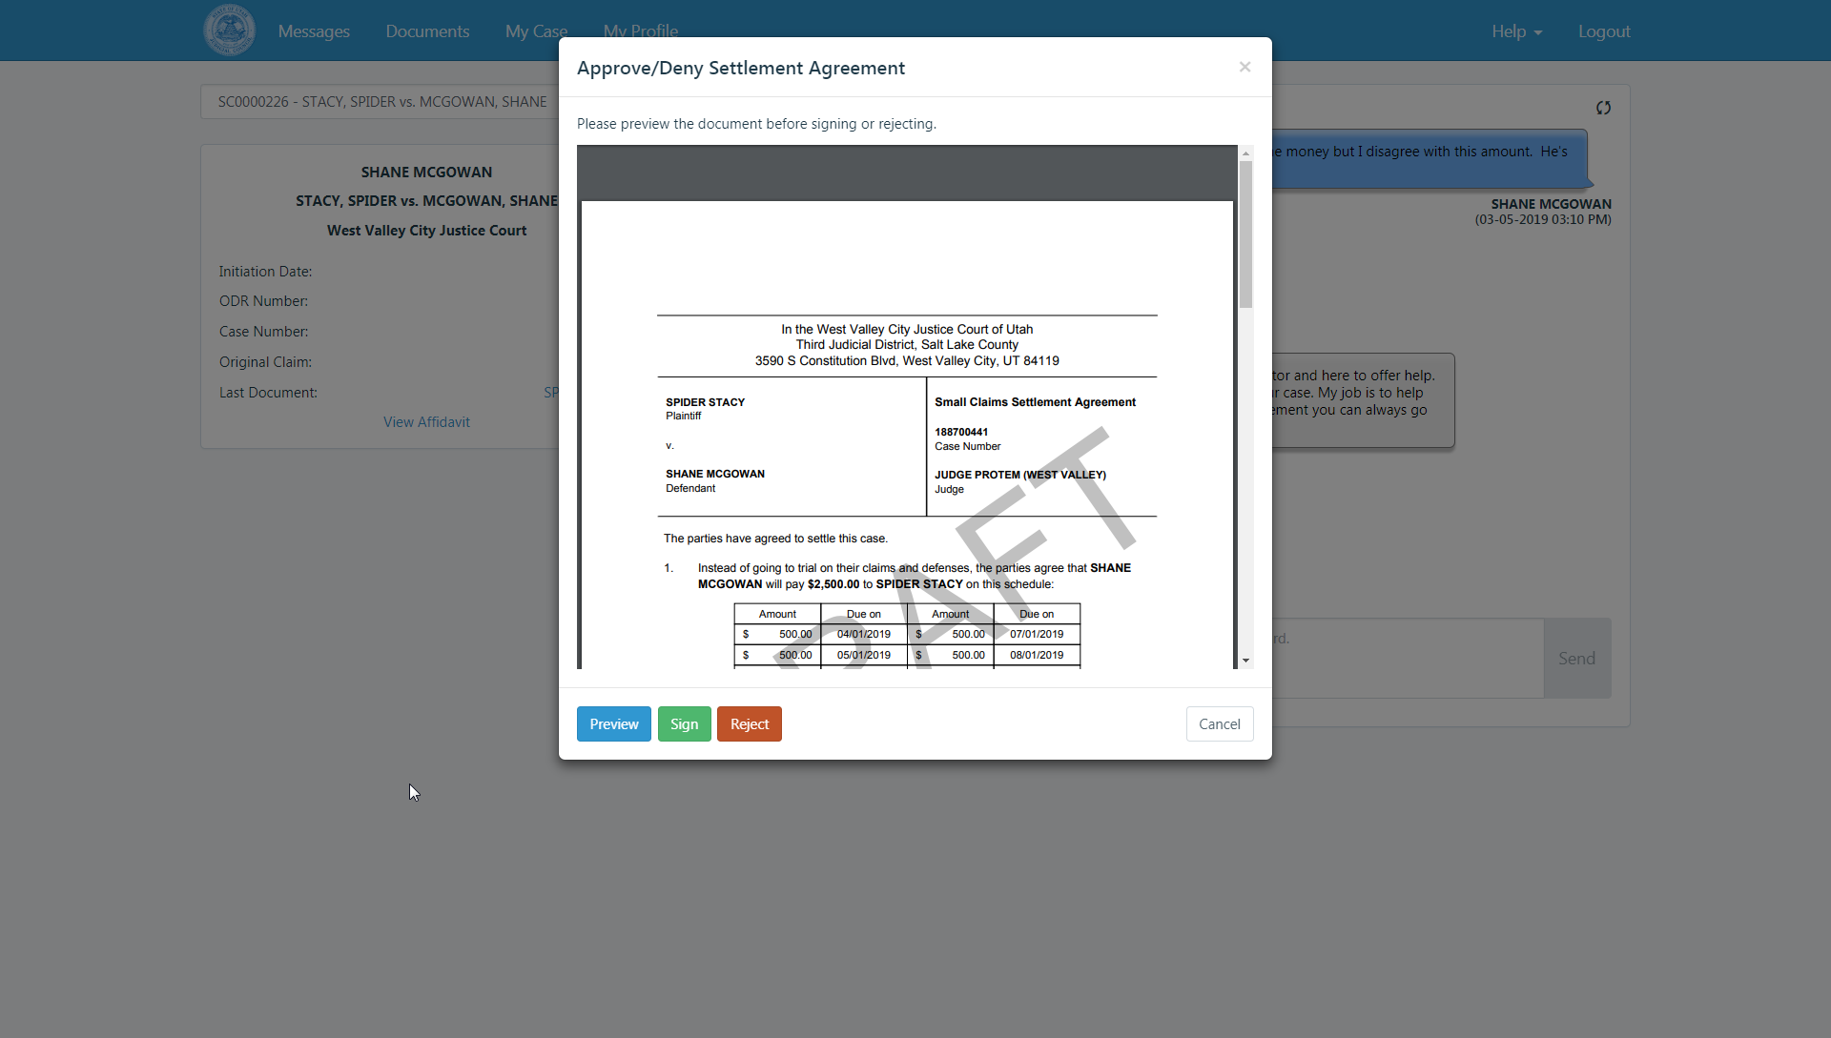
Notes:
The other party can review the document, and sign it or reject it.
It can be modified as often as needed.

Slide 35
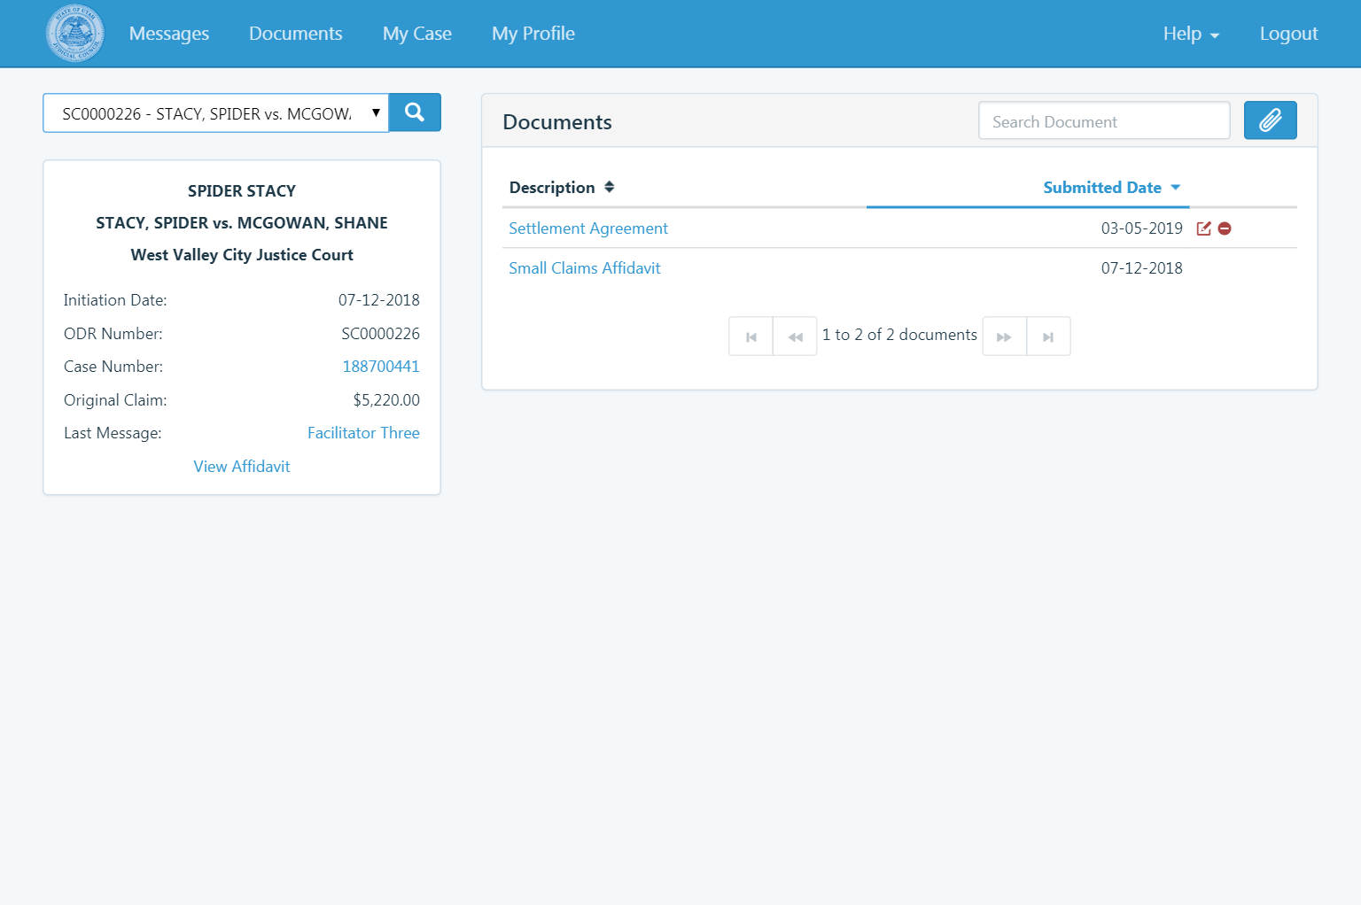
Notes:
When both parties have signed, the document is submitted to the court and entered into the court case.
The ODR process is closed.
Parties can now access their court case and the activity in it.

Slide 36
UX Study
Notes:
Notice
Registration

Slide 37
Virtual Hearings Study
Notes:
305 hearings, 6 law students
Engagement is key

Slide 38
New Jersey
Notes:
6 weeks to go live

Slide 39
Connecticut
Notes:
Traffic, specialized traffic

Slide 40
Michigan

Slide 41
Case Types
Notes:
Traffic
Taxes
Civil
Family matters
Criminal

Slide 42
Challenges
Court structures
Digital divide – perceptions and realities
Procedural constraints
Lack of imagination, reengineering
“Don’t know where to begin
Culture, wistfulness

Slide 43
Critical Success Factors
Project champions
Opt-in vs. Opt-out

