Slide 1
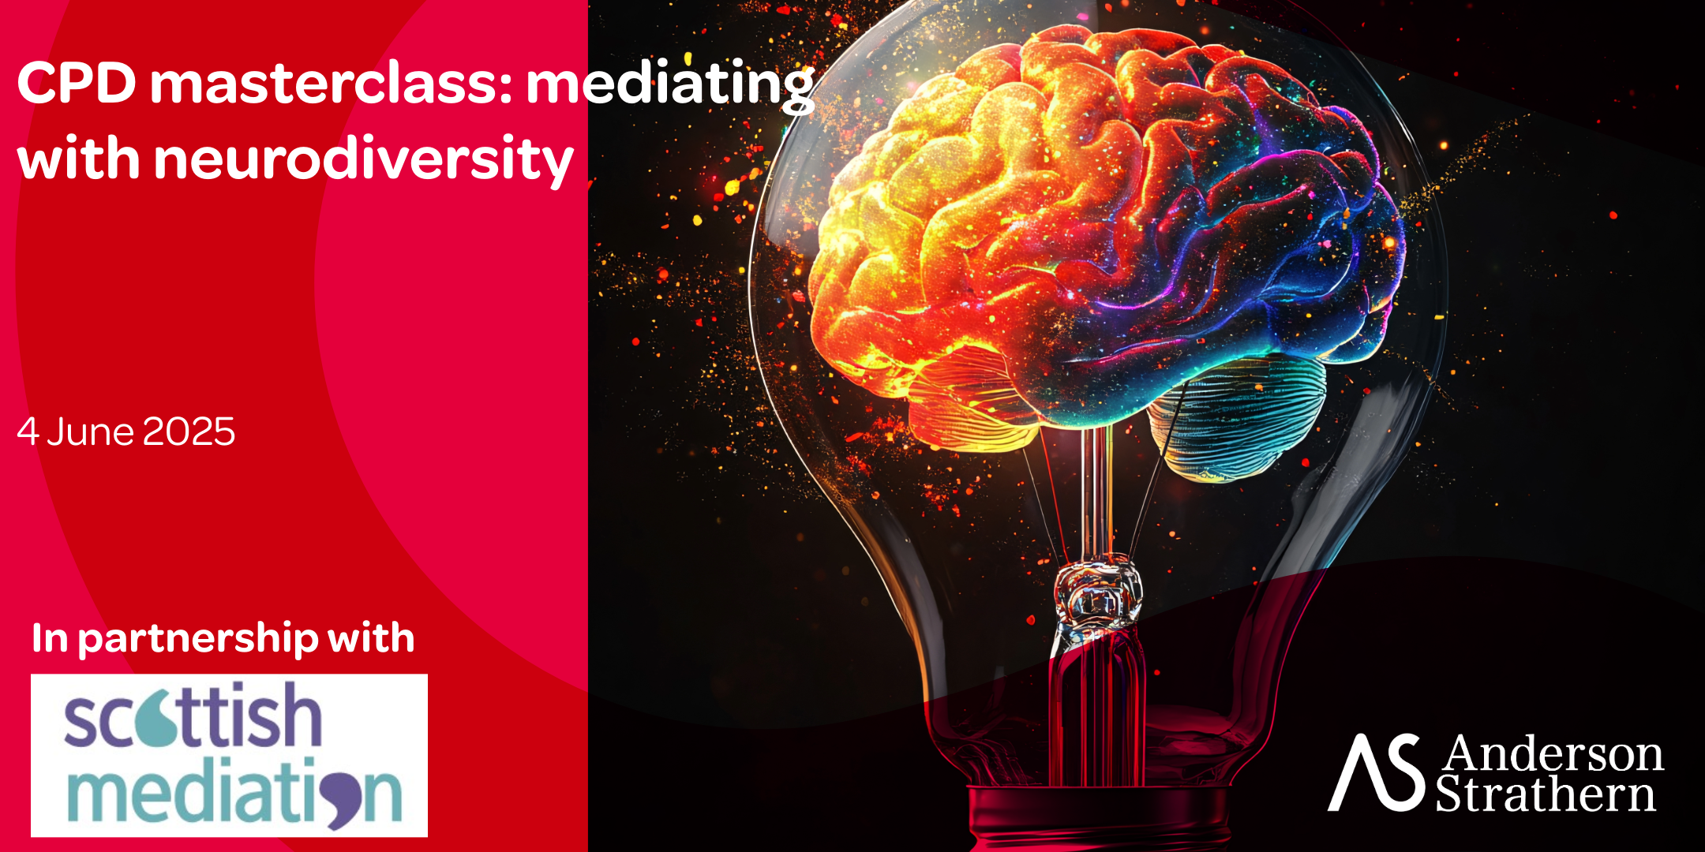
Community Case Study
First Level Complexities

Slide 2
Defining and embracing neurodiversity in mediation
Dr. Mike Talbot
CEO & Founder,
UK Mediation Ltd
Laura Kerbey
Founder, PAST
Positive Assessments Support and Training

Slide 3
What do we mean by
Neurodiversity?

Slide 4
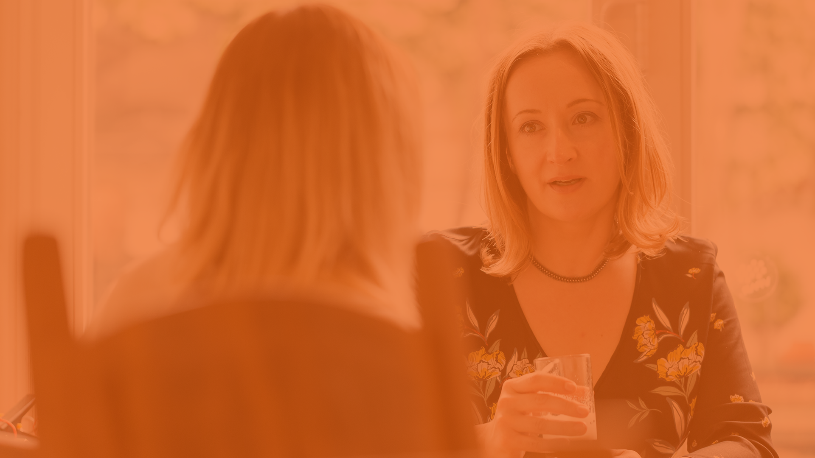
Neurodiversity refers to the natural variation in human brains:
…how people’s information processing, behaviours and traits can differ because of neurodevelopmental differences

Slide 5
Some neurodiversities.…
Autistic Spectrum Disorder (ASD)
Attention Deficit Hyperactivity Disorder (ADHD)
Dyslexia (difficulties with word recognition & decoding)
Dyspraxia (challenges with movement & co-ordination)

Slide 6
What is it like for the neurodivergent individual?

Slide 7
….essentially, differences between the person’s strengths and weaknesses are often magnified…

Slide 8
An autistic person
…may find socialising confusing or tiring, or become overwhelmed in loud or busy places
AND they may have intense interests, prefer & enjoy order and routine, and know how to keep calm and happy through regulatory behaviours

Slide 9
Someone with ADHD…
…may struggle to focus, may be hyperactive or impulsive (acting without thinking), and be restless and fidgety
AND be really creative, have high energy and resilience, be spontaneous and intuitive, and have contagious enthusiasm .

Slide 10
A closer look:
Autism

Slide 11
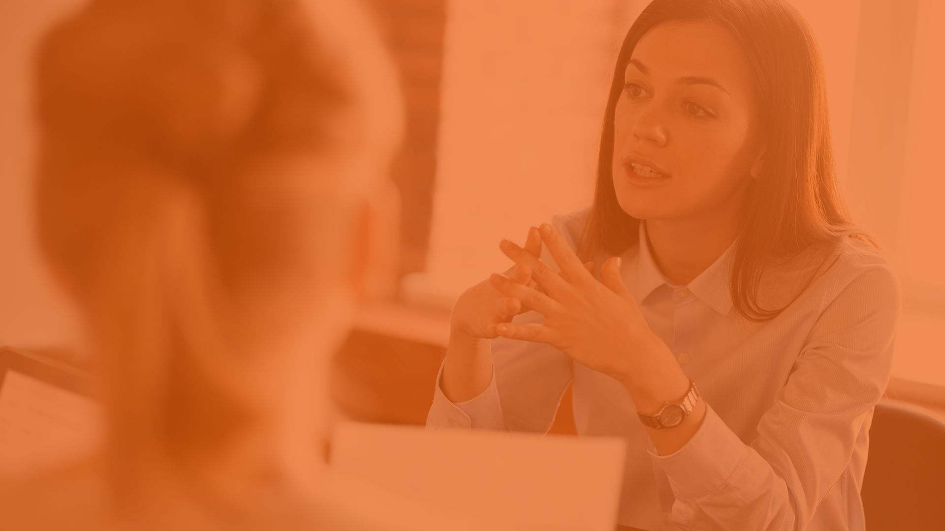
About autism
Often referred to as Autism Spectrum Disorder, with three common features that people may have difficulties with:
Interacting with others in social situations
Communicating with others
Experiencing the world through the senses

Slide 12
1 in100
people on the autism spectrum in the UK
Autism Society, 2025

Slide 13
700,000
autistic adults and children in the UK
Autism Society, 2025

Slide 14
Some positives of autism
Many autistic people say that positive characteristics of the condition include:
Being loyal
Being honest
Being focussed

Slide 15
Embracing ASD as Mediators
Someone with ASD may need:
More time to process information
Clear, consistent language, rather than abstract phrases
Less reliance on things like
- facial expressions - jokes and sarcasm - metaphors and similes
An understanding that they may not always hold eye contact, engage in banter, etc.

Slide 16
A closer look:
ADHD

Slide 17
About ADHD
People with ADHD show a persistent pattern of:
inattention, and/or
hyperactivity–impulsivity
that gets in the way of day-to-day functioning

Slide 18
1 in 25 adults
1 in 20 Children
(approximately) with ADHD in the UK
ADHD UK, 2025

Slide 19
2.6 million
adults and children with ADHD in the UK
ADHD UK, 2025

Slide 20
Some positives of ADHD
Many people with ADHD say that some of the positive characteristics of the condition include:
heightened creativity
intense focus (hyperfocus) when needed
a strong sense of adventure & spontaneity
resilience: an ability to bounce back

Slide 21
Embracing ADHD as Mediators
Someone with ADHD may need:
A setting with few distractions
Extra patience and support from the mediator(s)
Clear and concise language
Focussing on one point at a time & sometimes using visual cues
An understanding that they may sometimes speak without thinking and/or talk across other people

Slide 22
How might conflict arise around neurodiversity?

Slide 23
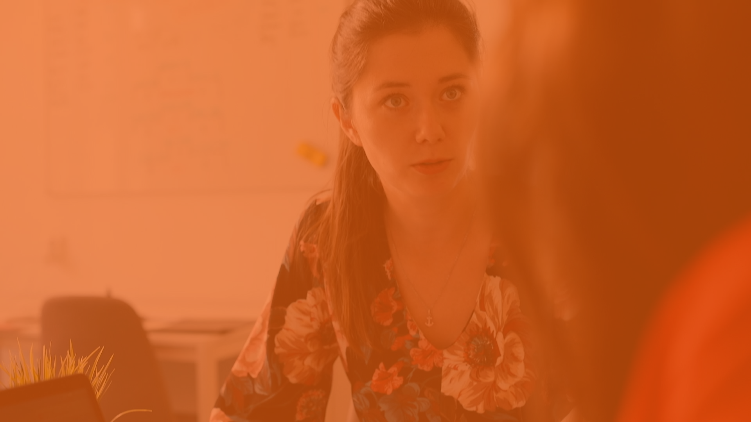
Finding some things relatively easy and others incredibly difficult can lead to confusion, frustration, and misunderstanding…

Slide 24
And, at work for example, can lead to issues…
Employers and authority figures may think that the individual isn’t trying or lacks ‘capability’ in relation to particular tasks

Slide 25
And can lead to issues…
Employers and authority figures may think that the individual isn’t trying or lacks ‘capability’ in relation to particular tasks
Behaviour can be misinterpreted as having poor motivation, a lack of focus, or a bad attitude

Slide 26
And can lead to issues…
Employers and authority figures may think that the individual isn’t trying or lacks ‘capability’ in relation to particular tasks
Behaviour can be misinterpreted as having poor motivation or a bad attitude
Neurotypical assumptions about the person’s behaviour can ultimately lead to discrimination

Slide 27
Why are these insights
Important to mediators?

Slide 28
To embrace neurodiversity, mediators must…
Consider that mediation might be based on neurotypical assumptions about ‘normal’, and that our goal is to ensure that mediation is inclusive, and equitable for all

Slide 29
mediators must…
Consider that mediation might be based on neurotypical assumptions about ‘normal’, and that our goal is to ensure that mediation is inclusive, and equitable for all
Listen to what neurodiverse individuals might need so that they can participate fully in mediation

Slide 30
mediators must…
Use mediation as a safe, non-shaming, and private opportunity for conversations about what people need from each other so that they can resolve their dispute

Slide 31
mediators must…
Use mediation as a safe, non-shaming, and private opportunity for conversations about what people need from each other to make their relationships better
Recognise that it is the mediation environment, and not the individual, that needs to be ‘fixed’

Slide 32
Over to Laura…..

