Slide 1
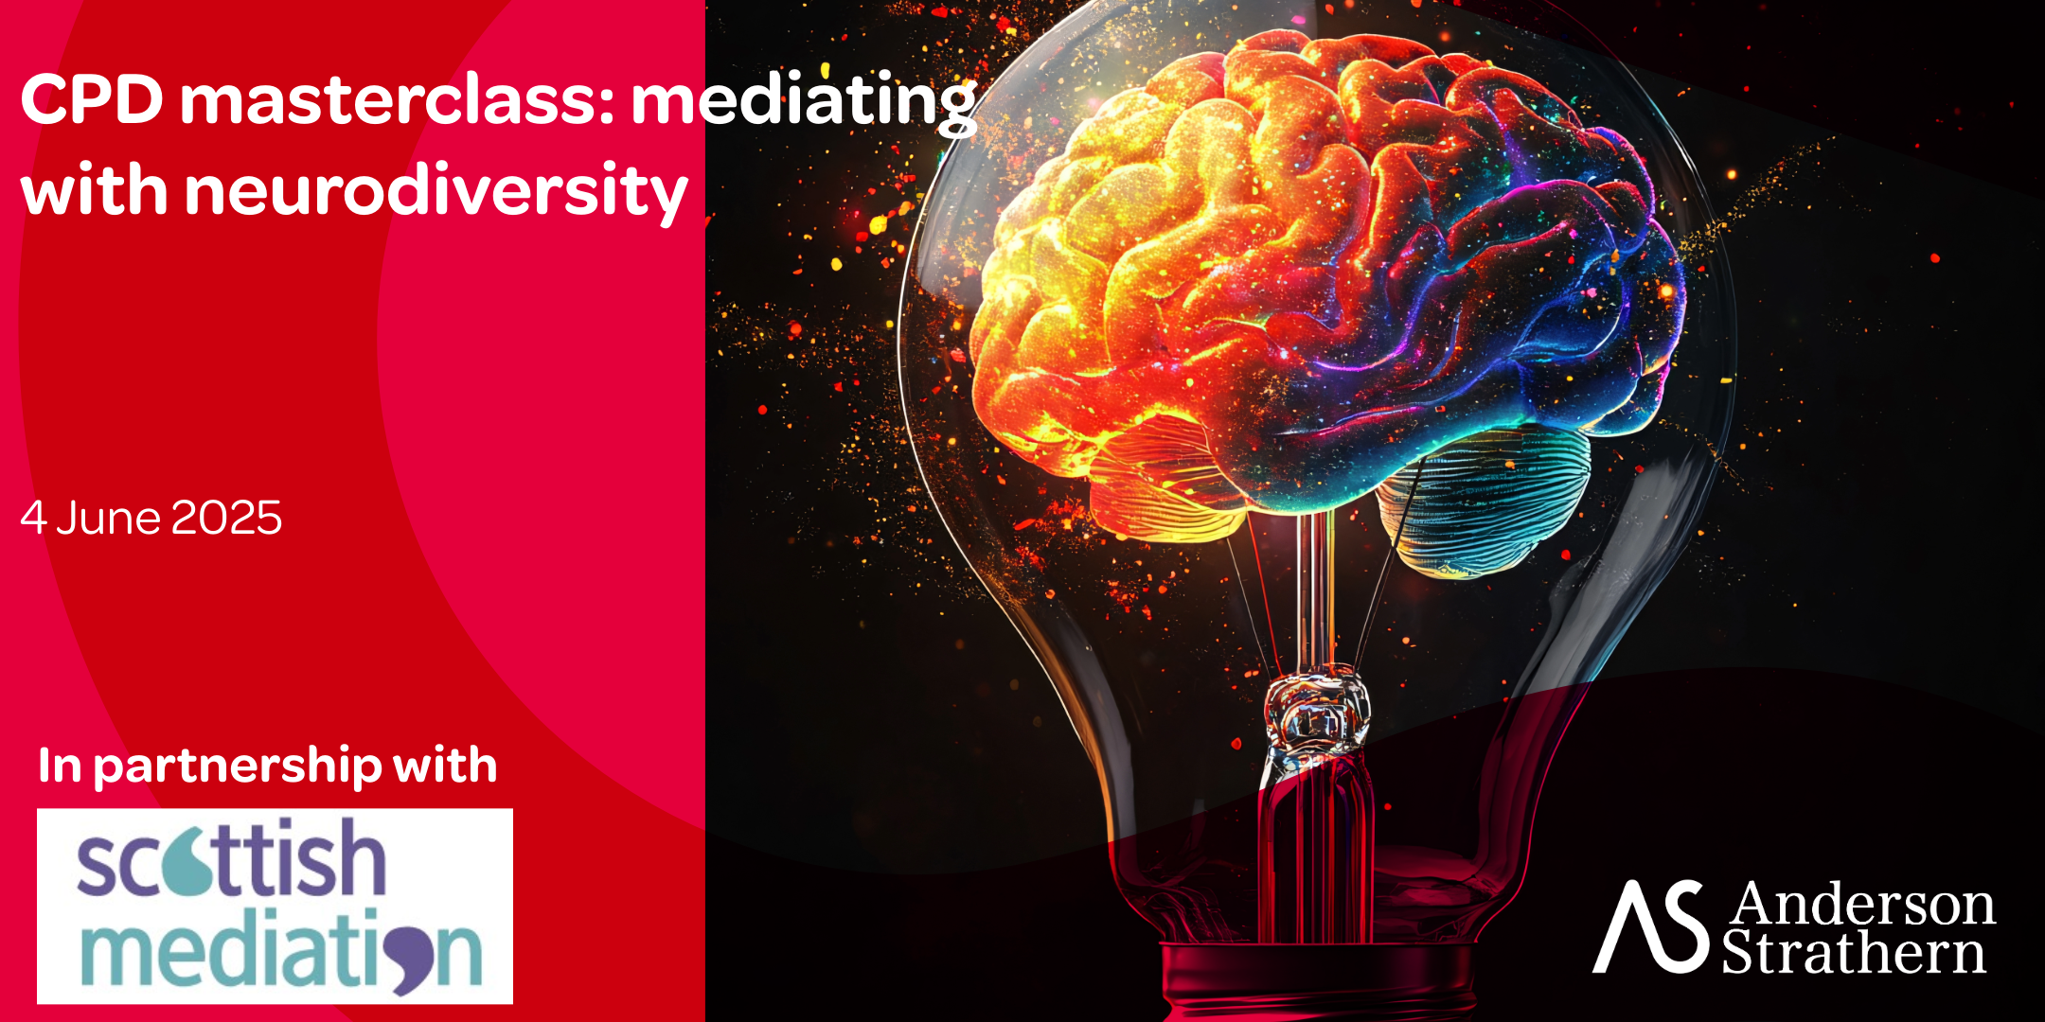
Community Case Study
First Level Complexities

Slide 2
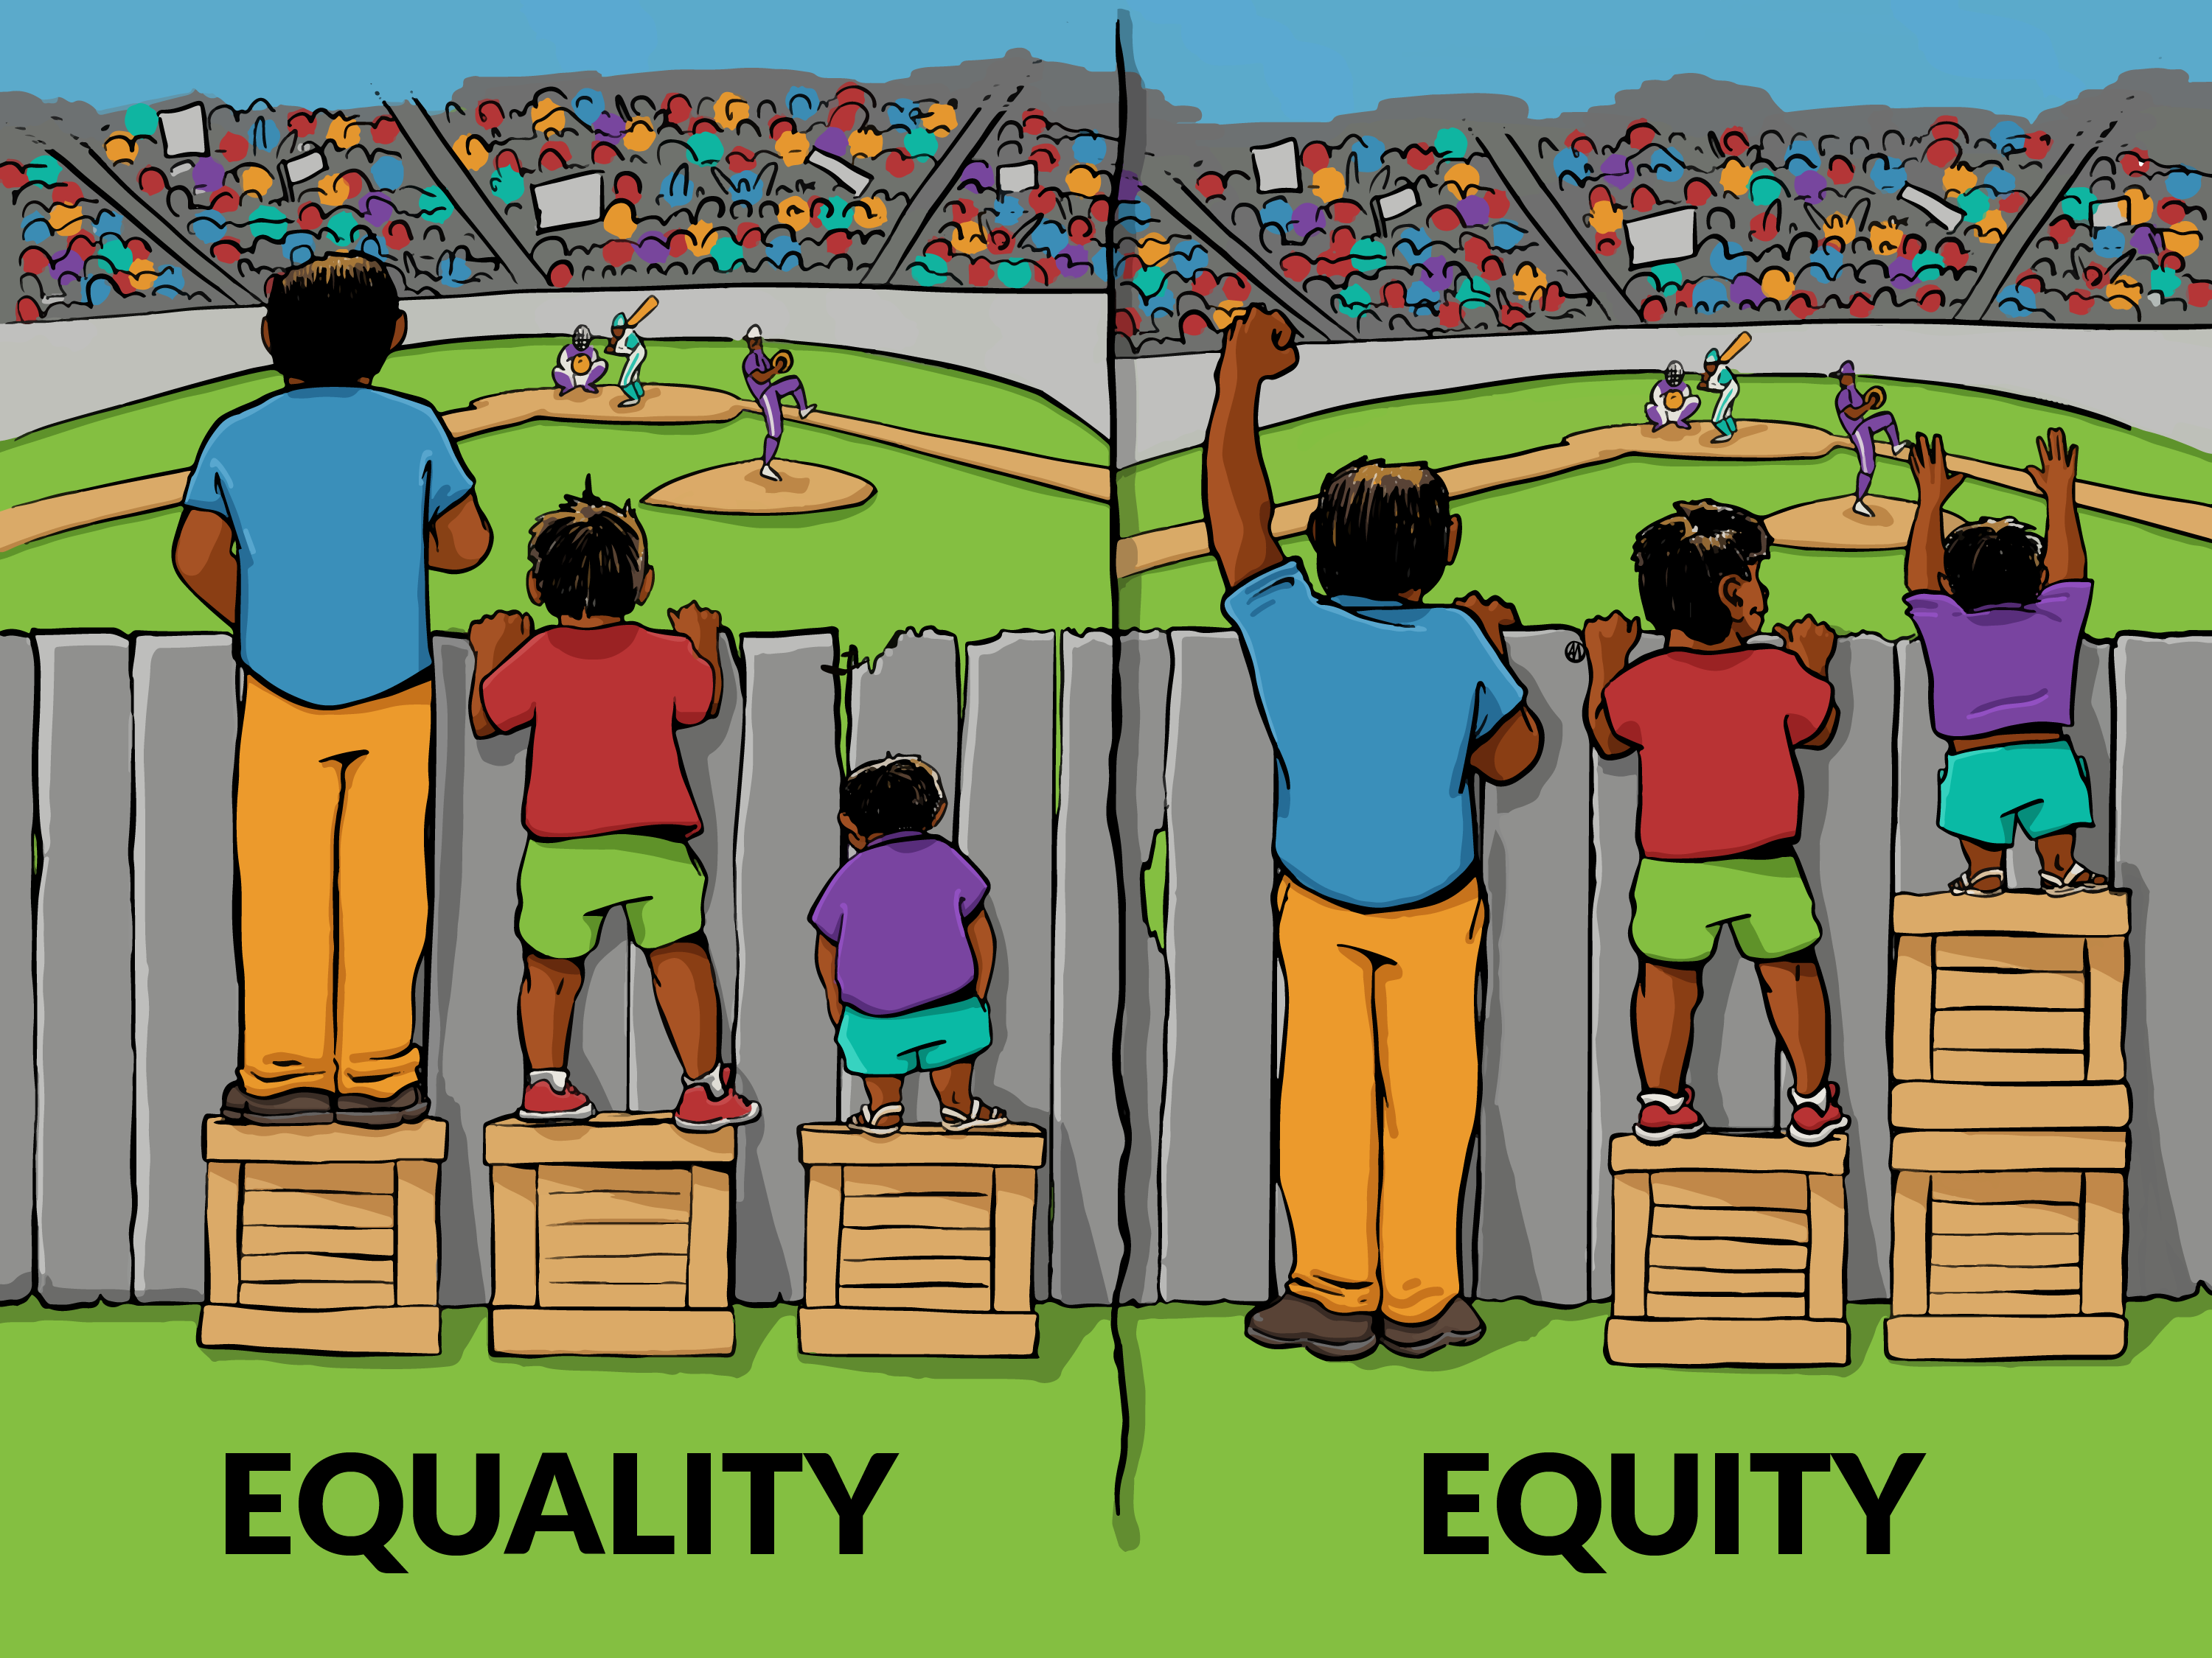

Slide 3
Discussion Points
Share an experience you’ve had with a neurodiverse party (who you weren’t aware were ND at the time). What went well? What could you have done better?
OR pose the following question:
How do we ensure equity while maintaining equality with ND parties?

Slide 4
Key Takeaways
Each ND individual is unique
We require a case by case basis for both individual and process
Mediations live and die by the relationship with the mediator- meet all parties where they’re at
Have faith in your ND parties- they can often guide you
Any ‘reasonable adjustments’ in mediations are inherently ethical unless harmful to another party

Slide 5
Cameron’s email: cameroncross239@gmail.com

Slide 6
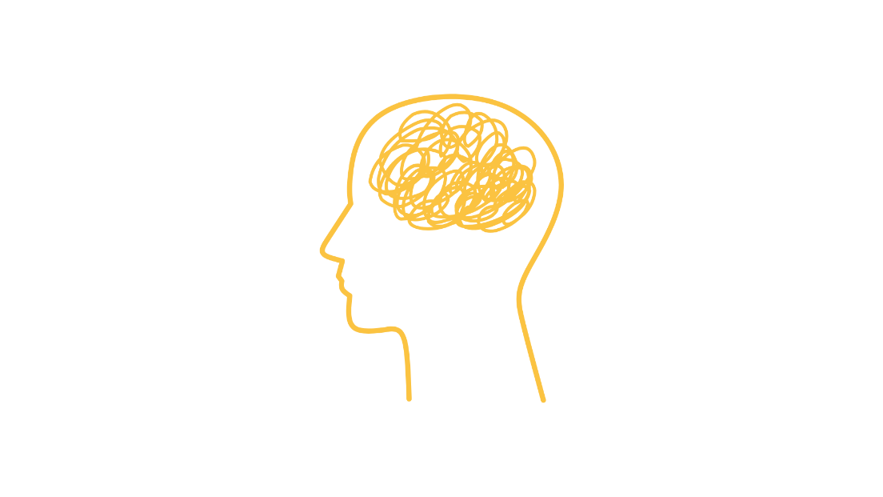
How we communicate?
Notes:
Understanding the context ​ - of how we share information , we often centre the issue on the neurodivergent person not listening but do we consider :
How we communicate
How other people process information
How quickly people can switch attention - and how we expect them to switch and transition from one part of a task to another.
​
Give a quick fire instruction , the next slide is what the finished drawing should look like ​
​
​
How often do we judge people when they don’t do something the way we do ​
​
Do we think about how we communicated, how we gave instruction or to we centre the issue on the person and their inability to get it -- if we do , then this sits within our percpetions of ND within the pathology paradigm.

Slide 7
How we communicate?

