Slide 1
Mediating with neurodivergent persons
Eve Pienaar – CEDR mediator
Laura Kerby – P-AST Founder
MBPsS. BSc (Hons), PGCE, PGCE (Autism), NPQH
Notes:
Slides 1 - 4 mins
Laura and Eve give 2 min intro each

Slide 2
Agenda
1. Neurodiversity – focus on Autism Spectrum Disorder
2. Practical application – mediation / neurodiversity
3. Focus on ASD – science / tips for mediation
4. Mediation process design – case study:
* Setting the mediation up for success
* Bargaining phase – tips and tools
5. Audience Q&A
6. Concluding remarks
Notes:
Eve to outline agenda – 1 min

Slide 3
Mediating and Neurodiverse parties (creating a safe space for dialogue)
Mediation entails working with diverse persons
Focus on ASD (but could include other conditions, eg: high conflict personalities)
Mediation: inclusive and available to all
Co-mediation with psychosocial expert?
Notes:
Eve: 2 mins bullet points 1, 3 and 4
Laura: 3 mins bullet point 2 + explaining the “umbrella” / client’s condition will vary during the mediation day according to stress levels etc
Laura: importance of “preferred language”: I am autistic rather than I have autism + disorder not disability
Total: 5mins for this slide [now at min 10 of 45]

Slide 4
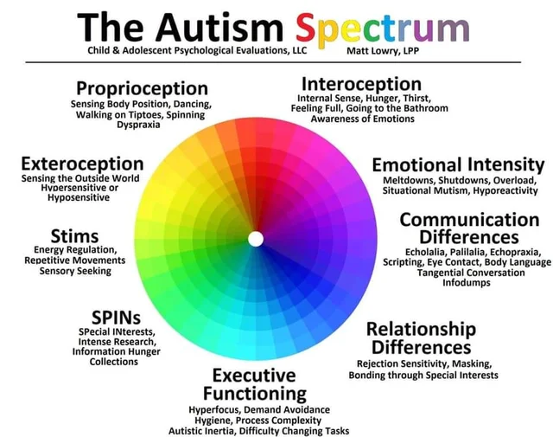
Notes:
Laura (3 mins approx.)

Slide 5
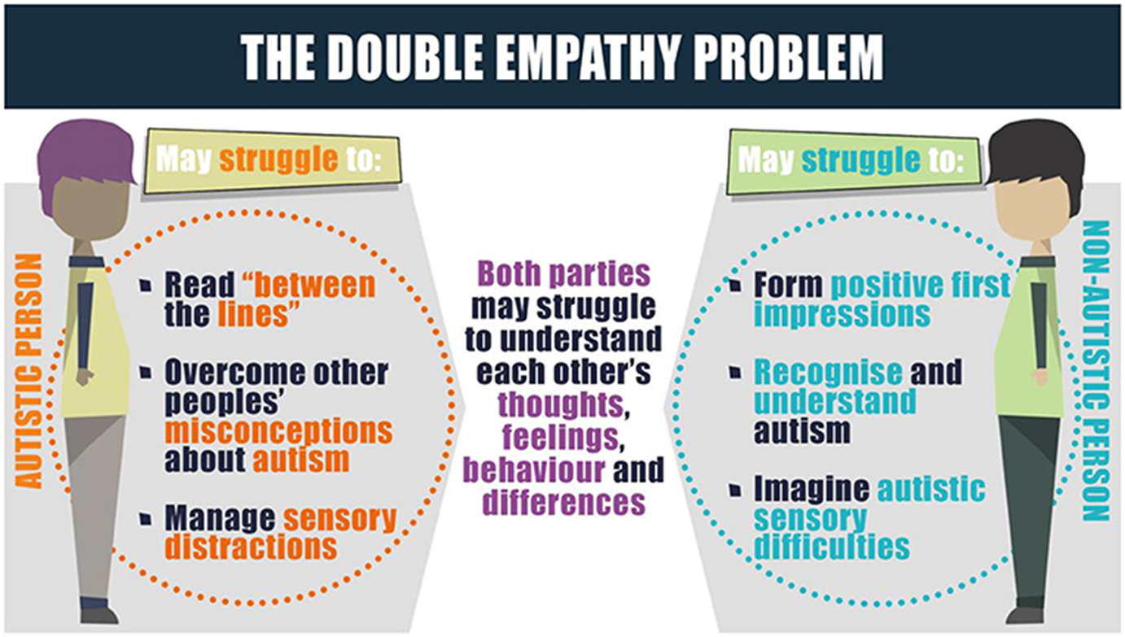
Notes:
Laura (3 mins approx.)

Slide 6
Notes:
Laura (2-3 mins approx.)
[we are now 19 mins]

Slide 7
2. Practical application - mediation
How to surface parties’ needs?
Anxiety management
Some parties may need more time – processing documents or concepts
Communication styles:
“Visual thinking” vs. “black & white thinking”
Come across as rude, direct?
Ability to see the other party’s point of view?
Detail orientated – ability to see “bigger picture”?
Ability to visualize options or risks?
Coaching a party to “influence” effectively
Jessica Park, USA artist with autism
Mediating with neurodivergent persons
Notes:
Eve: 5 mins
[now at 24 of 45 mins]

Slide 8
Mediation process design Anything I should know about you or your client, to help with the mediation process? If Party volunteers information – eg client “vulnerable” or “neurodiversity issues present” then consider adjustments such as:
Offer further preparation time with client?
Venue and support on the day?
“What do I have permission to share?”
“What would help you get the most out of the mediation?”
Mediating with neurodivergent persons
Notes:
(Eve. 5 mins)
[we are now at min 29 of 45]

Slide 9
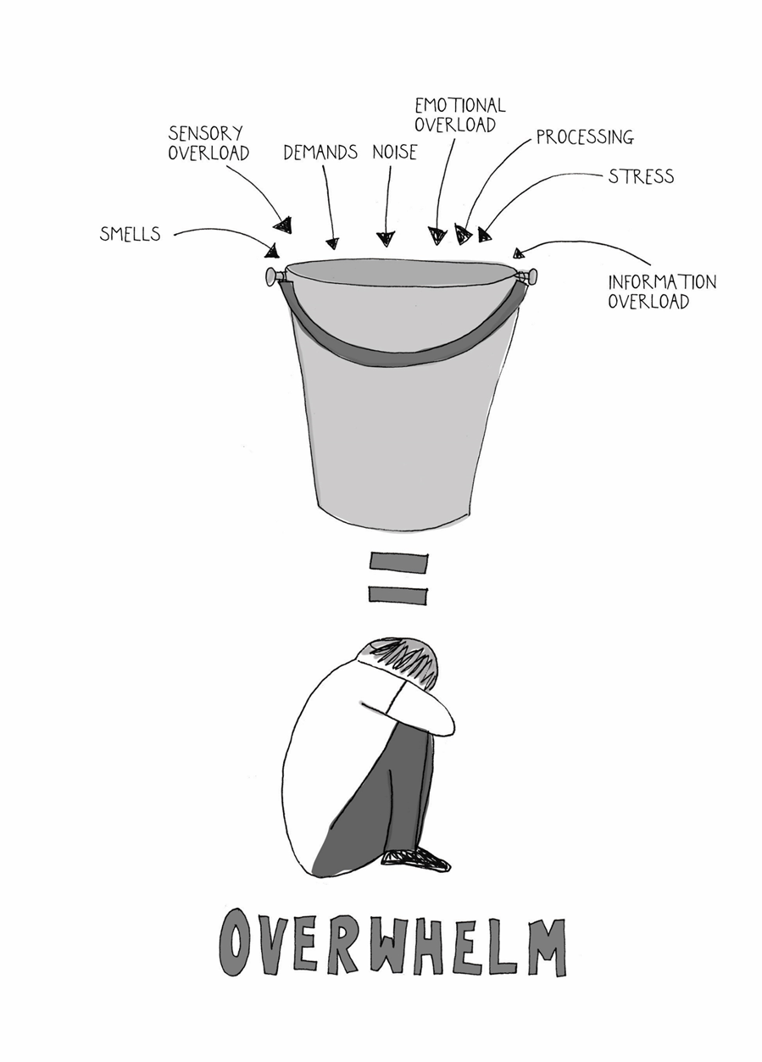
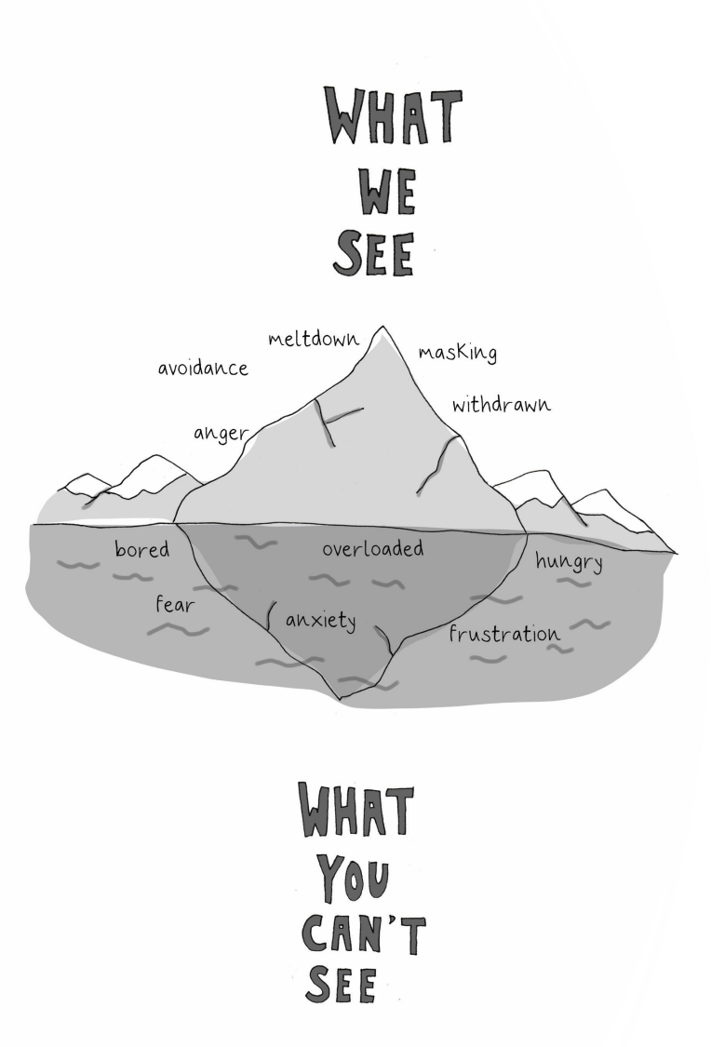
WHAT IS THE NEED BEHIND THE BEHAVIOUR?
The Anxiety Bucket analogy
Notes:
Laura 3 mins
[we are now at min 32 of 45]

Slide 10
4. Mediation process design – case study
Residential construction case – damages for defects
Identifying ASD present
Extra time BUT management expectations
The “36 PPT presentations” C wanted to share
Importance of working with the legal team
Insight from ASD therapist/ tips and tools
Notes:
Eve: 2 mins
[34 mins]

Slide 11
case study – preparation stage
Pre-mediation contact with parties
Preparing the papers – agreeing the Bundle
Crafting the agenda, with timings
Preparing for the joint session
Who to join on each side?
Ability to call for “time out”
Notes:
Eve – 3 mins
[37 mins]

Slide 12
case study – bargaining stage
How to elicit offers?
Framing offers so they can be “heard”
Managing disappointment;
Hitting deadlock
Moving from positions to interests
Drafting the settlement agreement
Ability to call for “time out”
Notes:
Eve and Laura – 3 mins
Eve black text bullets/ Laura blue text
[40 mins so 5 mins for questions]

Slide 13
Any Questions ?
Notes:
Frank to share from chat and also audience?

Slide 14
Thank you – and further reading
eve@evepienaar.com
Scattered Minds – Gabor Mate
The Autistic Brain – Temple Grandin & Richard Panek
Women and Girls on the Autism Spectrum – Sarah Hendrickx
Autism for Adults – Daniel Jones
Untypical – Pete Wharmby
The (Slightly Distracted) Woman’s Guide to Living with an Adult ADHD Diagnosis – Laura Kerbey – Out June 2025
Laura.Kerbey@p-ast.co.uk
mycedr@cedr.com

