Slide 1
Family Mediation
A Case study - Rose, Nigel and Harry.
Sarah Ross - Better Mediation 2025
Notes:
Good morning – I’m Sarah Ross from Better mediation – based in Edinburgh. I work with clients across the UK in family and workplace disputes. I am registered and liscensed to practice by the Fmaily Mediation Council in England and Wales and I am a member of Scottish Mediation. I had a long career in Marketing, PR and Sales before retraining in 7 years ago. Until recently I have been a high volume practioner clocking up over 400 indiviula intake meetings leading to over 70 proceeding cases ( each of 3 -5 sessions).

Slide 2
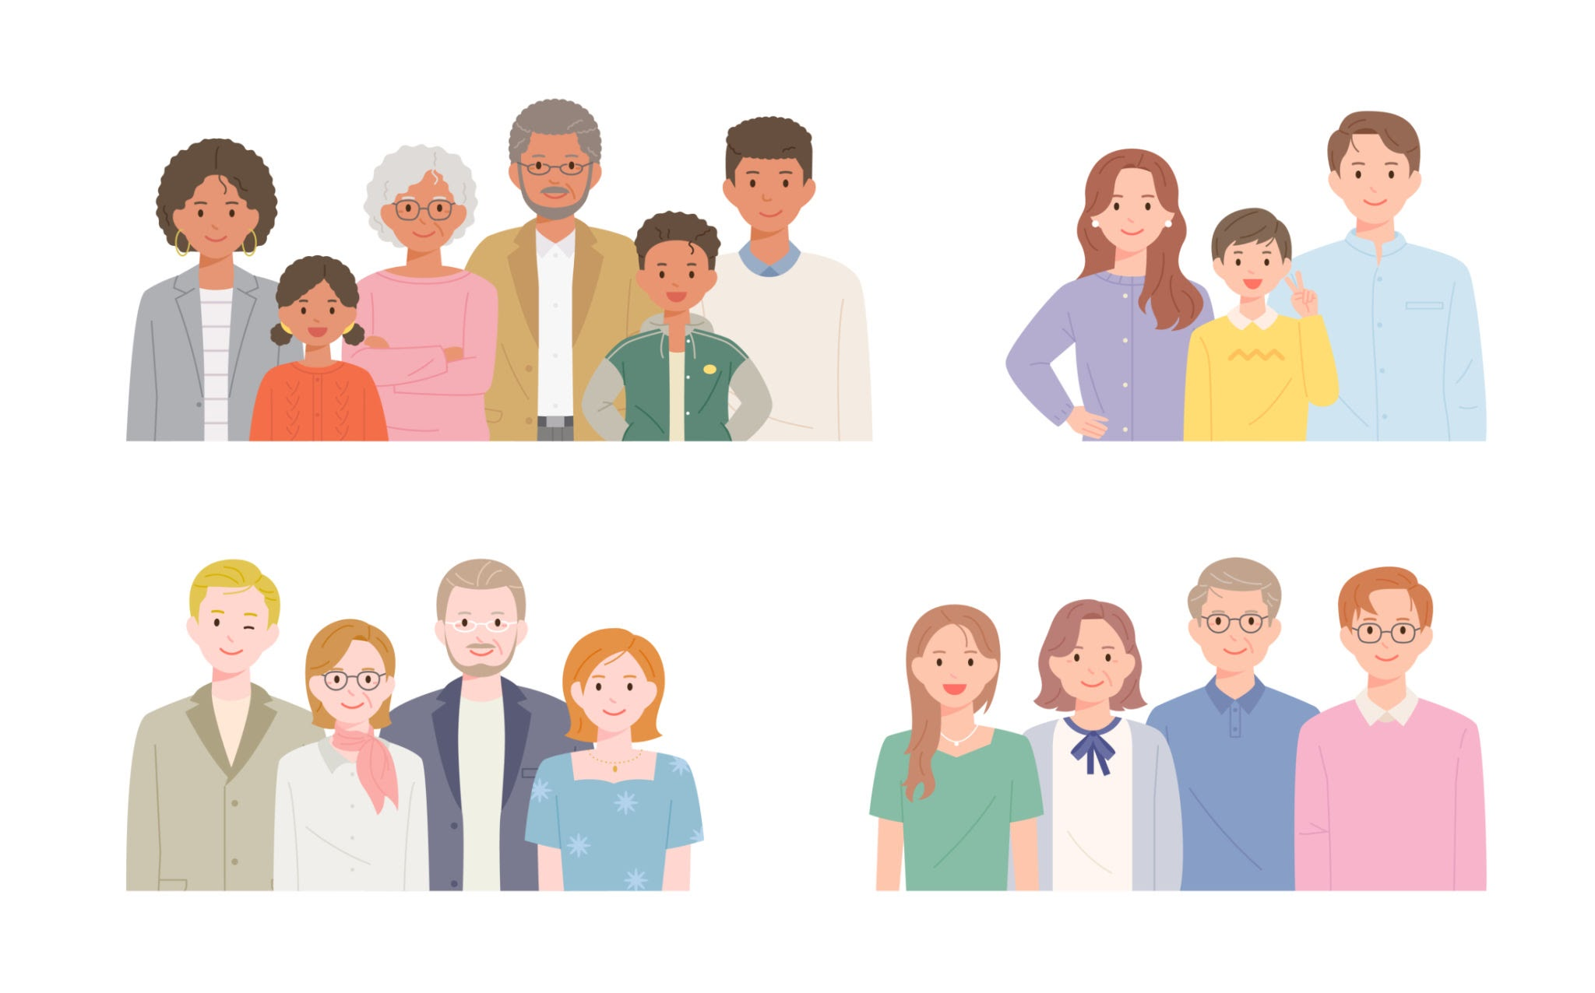
Family Mediation - A Case Study
A real life scenario
Notes:
This case study is not a clever fusion of the ‘best bits’ of others – this family is real , but the names have been changed.

Slide 3
Before we start - a quick overview
What can FAMILY mediation encompass?
Divorce and separation - negotiations re assets and children
Single issues - eg re-location within the Uk, parental responsibility, name change and fertility treatment
Cross border and International
Multi generational or Elder’ issues

Slide 4
Family Mediation - a case study
An overview of the process
• Initial one to one meetings
• Proceed to joint mediation sessions – 10 hours in total with these clients.
• 2-4 sessions but may be more
• Agree outcomes - summary of financial proposals, separated parents agreement?
• Legal Advice - Minute of agreement
Notes:
The ‘story’, rapport and suitability)
–2 clients and 1 or 2 mediators
Confidential ( with some exceptions) and in Scotland - voluntary. The equivalent meeting in England is called a MIAM and is compulsory ( with exemptions).
I don't intend to refer to the process South of the Border again, but stop me in the break if you have any questions about this.
Change Minute of agreement

Slide 5
Family case study
Let’s meet Rose and Nigel.The 1:1 meetings revealed….
• Rose and Nigel have been together for 8 years ( 4 of those married)
• They have one son Harry aged 9
• Rose disclosed that Harry has been diagnosed with “high functioning Asperger’s” and Rose has been assessed recently too and believes she has “Asperger’s”
• Rose has other complex medical issues meaning she can’t work.
• Virtually all communication has ceased & they now want to divorce
• They have sought mediation to agree a settlement which allows Rose and Harry to stay in the existing house (adapted for Harry’s needs)
Notes:
• Their families were heavily involved in supporting their family life ( Rose's parents paying for adaptataions for the house for Harry and Roses's parents funding the deposit. .Rose and Nigel believe it is essential that Harry continue his current routines at school and his current medical and dental care
• The 1:1 initial meetings took place in June 2020 and 4 joint sessions were held 6 sessions in total– they reached agreement in February 2021
Neither parent can drive. Nigel is seeking new employment in IT. Both are legally aided

Slide 6
SUITABILITY
Is mediation the right process for Nigel and Rose?

Slide 7
Family Mediation- a case study
Issues for me to consider prior to the first joint meeting
• Respect the language used by clients to describe their or a family members neurodiversity.
• From my preparation session with Nigel, do I need to consider that he may also be neurodiverse?
• The parents display very different attitudes to parenting
• Adaptations to the process given the disclosures so far?
Notes:
This isn’t a unique adaptation but covid = isolation, disruption, redundancy plus online working? 85% of my work is now online and we could have a conference ONLY about that topic and it’s suitability? Universal themes regardless of whether ND is factor.
Any sensitivities?
how could I adapt to ensure balanced communication?
Covid ( online sessions only)
Agreement to Mediate

Slide 8
Family Mediation - a case study
What happened next?
What is their ‘normal’?
Striving for balance
Bending the ‘rules’ to get to agreement
Notes:
I have written this case up for another project and Striving for Balance - detachment or manipulation/ dominating/retreating
how can we know what is ‘normal’ interaction between clients
expect the unexpected - pressure on the mediator
unforeseen safeguarding issues

Slide 9
Family Mediation - a case study
The 3 important questions we were asked to consider
Question 1 -What did I know beforehand?
- The client’s “story”
- The Neurodiversity in the family.
Notes:
The family mediation process offers us this insight, but despite that, there are always surprises.
Clients ‘story’ sounds patronising, it’s a unique opportunity. You may be the first to hear it,

Slide 10
Family mediation - A Case Study
Question 2 - what do I WISH I’d known beforehand?
More about the relationship dynamics and their ‘positions’ regarding the split
How difficult the financial disclosure process would be.
Notes:
Meaningful adjustments - my toolkit. ATM? A bit flippant but….put up link to toolkit. The good times - i brought them back to the micro re Harry - dismantling things and re-buidling to bring in some focus. they have had good times.

Slide 11
Family mediation - a case study
Question 3 - what did I learn?
Neurodiverse Parents in conflict are parents in conflict
Parents of neurodivergent children may face huge additional challenges - but make no assumptions
Be wired - try and notice everything!
Notes:
Parents in conflict are just parents in conflict - NO that’s not a typo. A Relationship ending can be shattering.

Slide 12
Family Mediation - A Case Study
Question 4- what would I do differently next time?
Consider Child Inclusive Mediation for Harry
Allow time for a caucus
Be satisfied, but not complacent!
Notes:
“Doing the footwork and then letting go of the outcome” from Bringing Peace into the room recommend Stocco?

