Slide 1
Workshop
View from the mediation room – how practical is it to mediate with neurodiverse families?
An exploration of the issues and an opportunity to exchange experiences.

Slide 2
INTRODUCTION

Slide 3
ABOUT US
Sarah Ross – Founder, Better Mediation
Nadine Martin – Head of Family Law, Partner – Gibson Kerr

Slide 4
What can you expect from this session?

Slide 5
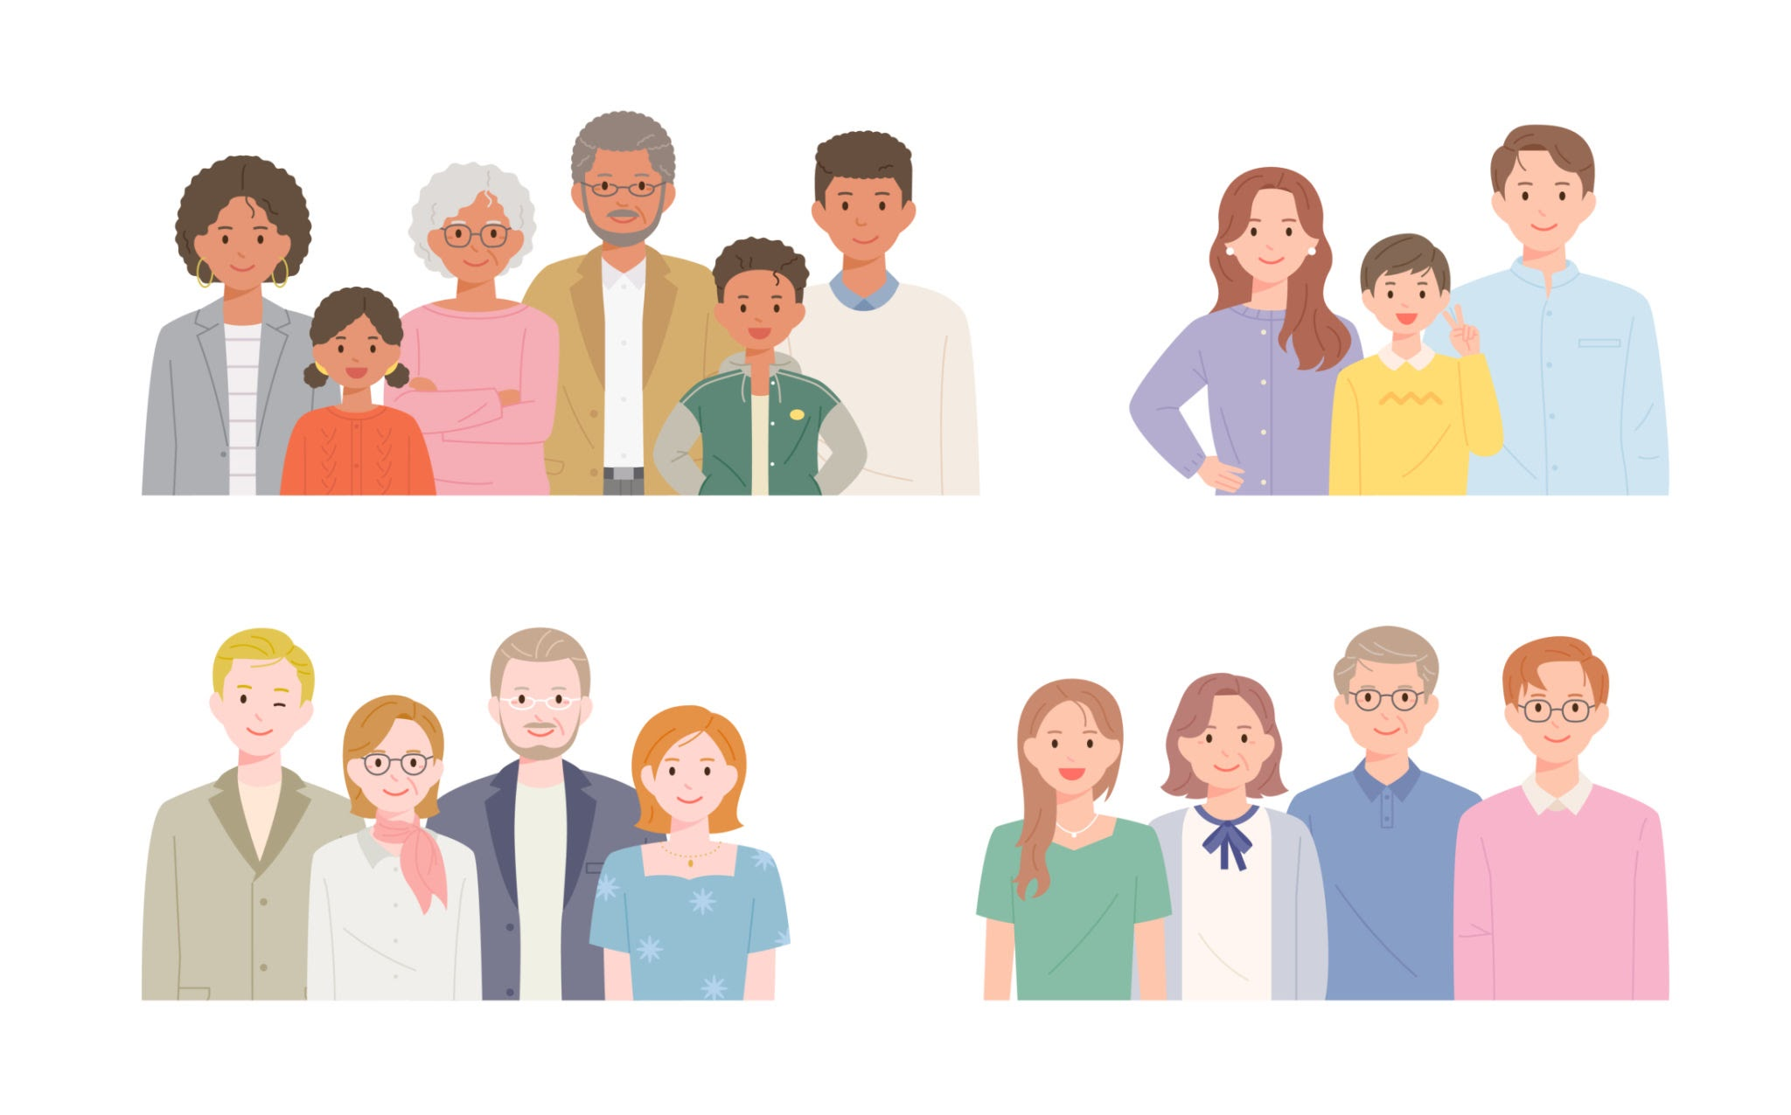
Let’s start with our clients – what is a neurodiverse family?

Slide 6
Back to the question…. How practical is it to mediate if neurodiversity is a factor ?

Slide 7
The beginning
The importance of GOOD FOUNDATIONS

Slide 8
Good Foundations
Our top 10
Be curious
Be clear
Be engaged
Be sensitive
Be adaptable – leaving behind our professional persona
Notes:
detachment or manipulation?
how can we know what is ‘normal’ interaction between clients
unforeseen safeguarding issues

Slide 9
Good Foundations
Our top 10
Understand the diagnosis
Provide practical support
Establish boundaries
Set expectations
Seek advice
Notes:
detachment or manipulation?
how can we know what is ‘normal’ interaction between clients
unforeseen safeguarding issues

Slide 10
Any questions
or comments?

Slide 11
The Middle … the mediation begins
The Agreement to mediate
Is this fit for purpose?
How tailored can it be?
What about confidentiality?
The Toolkit http://www.flanctoolkit.org/
Notes:
detachment or manipulation?
how can we know what is ‘normal’ interaction between clients
unforeseen safeguarding issues

Slide 12
Agreement of process?

Slide 13
The Middle … the mediation begins
Have a plan
But try and be reflective and adaptable
Notes:
detachment or manipulation?
how can we know what is ‘normal’ interaction between clients
unforeseen safeguarding issues

Slide 14
The Middle … the mediation begins
Being effective
Being humble? What did I miss?
The challenges of virtual vs in person
Some key issues are the same
Coaching
Parental attitudes to children and their diagnosis
My rights my say - CIM
Co - mediation
Notes:
detachment or manipulation?
how can we know what is ‘normal’ interaction between clients
unforeseen safeguarding issues

Slide 15
Any questions
or comments?

Slide 16
The End of the Mediation
Asking for feedback
Follow up materials
Complaints
Notes:
detachment or manipulation?
how can we know what is ‘normal’ interaction between clients
unforeseen safeguarding issues

Slide 17
Final reflections
When is mediation impossible or inappropriate?
Hard Lessons
The saviour complex
Where next for these clients?
Notes:
detachment or manipulation?
how can we know what is ‘normal’ interaction between clients
unforeseen safeguarding issues

Slide 18
A thought to leave you with..
Mediators are responsible for the process –
we are not responsible for the outcome.
Notes:
detachment or manipulation?
how can we know what is ‘normal’ interaction between clients
unforeseen safeguarding issues

